Slide 1
Introduction to
Pybricks for FLL Teams
MD FLL Mentors Group
3 October 2026
Rev 20
Boyd Fletcher
fllcoachboyd@gmail.com

Slide 2
Section Overview
Section 1 – Introduction to Pybricks
Section 2 – A comparison of Pybricks’ Block Coding and Python modes
Section 3 – How to use hub_menu()
Section 4 – Overview of Core Pybricks Python Functions
Section 5 – Building & Using a Pybricks Robot Library
Section 6 – Robot Game
Conclusion

Slide 3
Section 1 – Introduction to Pybricks

Slide 4
Introduction
This presentation is intended as an introduction to Pybricks for FLL Coaches and team members
This presentation will provide quick comparison of Pybricks Block Coding and Python modes followed be a core essentials overview of Pybricks Python
  Line-by-line details for block coding and python code are in the slide notes for each slide
This is part of a new series of presentations and documentation that is being developed by the MD FLL Mentors Group to help coaches and their teams succeed at FLL
  The information will will be posted on the https://marylandfll.org website later this year
This presentation, examples, and my Python course are available here:
  https://github.com/bcfletcher/lego_projects/tree/main/FLL/2026_MD_FLL_Coaches_Conf

Slide 5
Caveats
Using Pybricks does not require you to know Python if you use the Block Coding mode
Knowing at least one modern programming language (C/C++/C#, Java, Perl, JavaScript) will help with using Python in Pybricks
Everyone needs to know the basic program structure rules for Python, This is covered in a separate presentation we have
This course is NOT a complete overview of Pybricks – it is an introduction to get you and your team started using it.
All the code in this course are released under the Apache License v2.0
  https://www.apache.org/licenses/LICENSE-2.0.txt

Slide 6
Block Coding vs. Python
In MD, many elementary schools teach Scratch which is an approach to block coding developed by MIT
  While structurally different than the Lego and Pybricks Block coding, the concepts are similar
For elementary school students with limited typing skills block coding is probably the best approach
For middle schoolers, Python offers a lot of advantages
  Prepares them for high school level programming classes in Python and Java
  Python has much better capabilities to support finding bugs in your code (called debugging)
  It is much easier to support code reuse and robot libraries in Python than block coding
  Using Python lets you do nifty things like be able to run a bunch of steps (parts of the task that are working well) then “stopping” after a certain number of steps so the team can “go step-by-step” as they debug a new parts of the task

Slide 7
Why use Pybricks (1/3)
It is awesome!
Supports Lego Technic, Spike Prime/Robot Inventor, & EV3 Robotics Kits
Supports both Block Coding (graphical) and Python coding
  The backend of the Block Coding is actually Python so it provides a way to transition from Block Coding to Python
  Pybricks’ Python version is free and its block coding version is available for a small fee (to support its development)
Designed specifically for Lego Robotics!
  Robust and easy to use support for Spike Prime’s Gyroscope
  Simple but powerful commands to drive straight, turn in place, and drive & turn (called a curve/arc)
  Very precise but easy to use control over the Hub, Motors, and Sensors

Slide 8
Why use Pybricks (2/3)
Enables code reuse and good coding best practices by storing all code in .py (Python) text files
  Supports importing of code libraries to improve sharing and reuse of code
  Lego Spike Prime stores its code in a proprietary binary format and does NOT support using code libraries
Pybricks uses an HTML/JavaScript (web) based interface (requires Chrome or Edge)
  Can be “downloaded” to the computer so Internet access is not required
Works on Windows, Macs, Linux, and Chromebooks
Supports use of text-based code editors like Microsoft’s free Visual Studio Code
  See https://code.visualstudio.com
  See https://pybricks.com/project/pybricks-other-editors

Slide 9
Why use Pybricks (3/3)
Easy Multitasking
  Allows the robot to do multiple things at the same time
    Like driving backward while turning and lifting an attachment while moving away from a mission model
  Frequently used to drive or turn while also moving the attachment into the right position
    This can save valuable seconds during the robot game
  Used for stall detection for attachments to prevent the robot from “locking in place” while trying to move an attachment that is somehow gotten stuck on a mission
hub_menu()
  Provides a way to run multiple tasks on the robot
    Each task selected by use the <- -> keys on the hub and pressing the big button to run
  Loads all the tasks at one time onto the robot
  Replaces the task download capability in Lego Spike Prime application
  After each execution of a menu option, the menu starts from the beginning

Slide 10
Where do I get Pybricks?
It is a open source project so the source code is available
The software:
  Using the Chrome web browser go to: https://code.pybricks.com
The documentation:
  https://docs.pybricks.com/en/latest
The Getting Started Guide:
  https://pybricks.com/learn
Support Site:
  https://github.com/pybricks/support

Slide 11
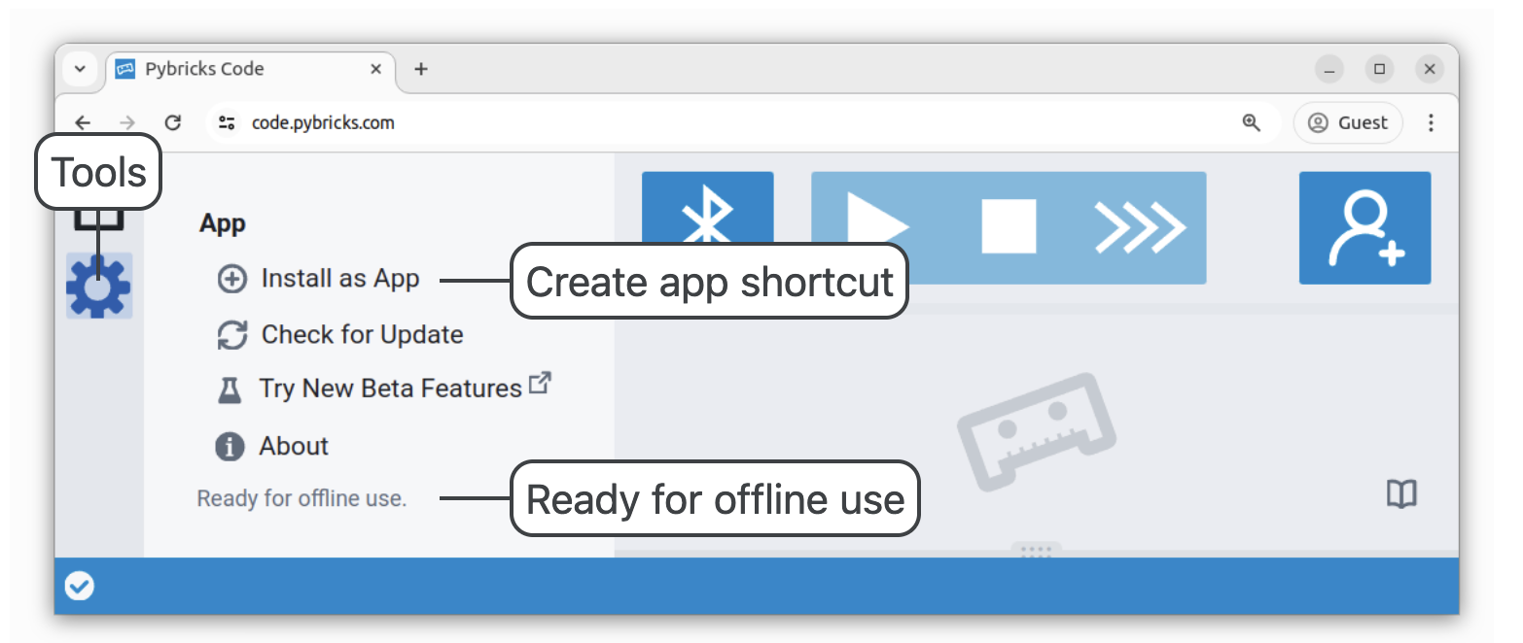
Installing Pybricks for Offline Use
Go to code.pybricks.com using Chrome
Press the Tools Gear icon, then press “Install as App”
You will then only need Internet access to install new firmware on the robot and to update the app, which is only a few times a year
You may need admin access on the computer to install the applicatrion

Slide 12
Pybricks Factoids (1/2)
All distance measurements are in millimeters (mm)
To move in the opposite direction you usually use a minus (-) sign before the distance or angle
Both Block Coding and Python can use comments to document your code
Use the print() function to help with debugging your code
  The output of the print function is sent from the robot to the Pybricks Editor to be displayed in the output window.
  It also works with Pybricks when using Visual Studio Code as the user interface.

Slide 13
Pybricks Factoids (2/2)
To use Pybricks, the firmware (e.g., operating system) on your Lego Spike hub will need to be changed
  You can revert back to Lego’s firmware if you decide you don’t like Pybricks
Once the hub is updated to Pybricks and you have installed the Pybricks app in Chrome; an Internet connection is no longer needed
Gyroscope makes driving long distances reliable
  Better resilience against flaws in the game table
  A “bump” at an mission doesn’t necessarily ruin a run
  Always disable the gyro at the end of a task
    So if you pick the robot up it doesn’t go crazy!
Pybricks runs the open source MicroPython interpreter on the robot

Slide 14
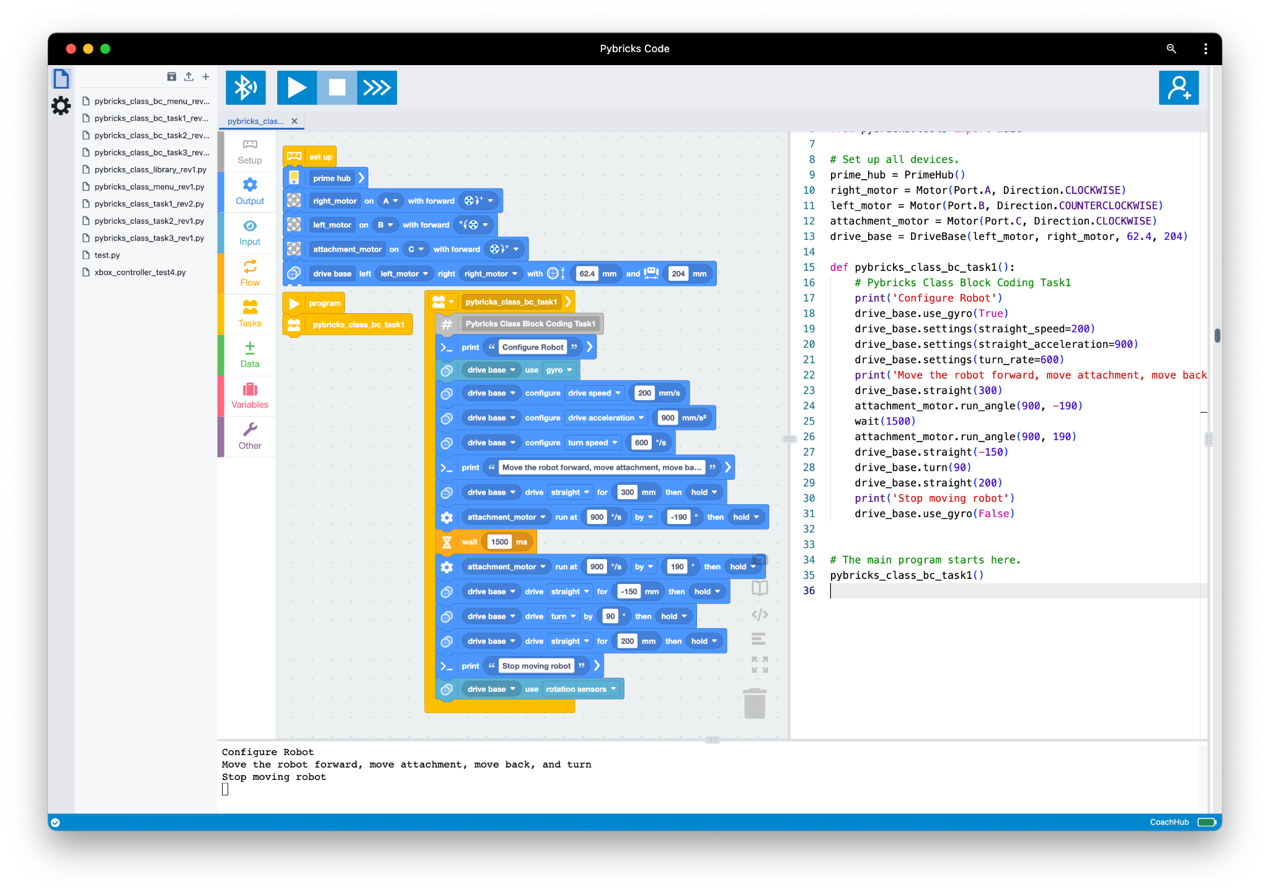
Pybricks User Interface (UI)
Press to run your code, called the Play button
Press to stop your code, called the Stop button
The list of programs currently loaded into the Pybricks User Interface
Used to manually run Python commands on robot using the output window (not commonly used)
The Palette of available of block coding commands
Your program in Python - updated automatically as you change the block code
Your program in block code
Output window that shows the output of your print statements, code syntax errors, and errors from the robot

Slide 15
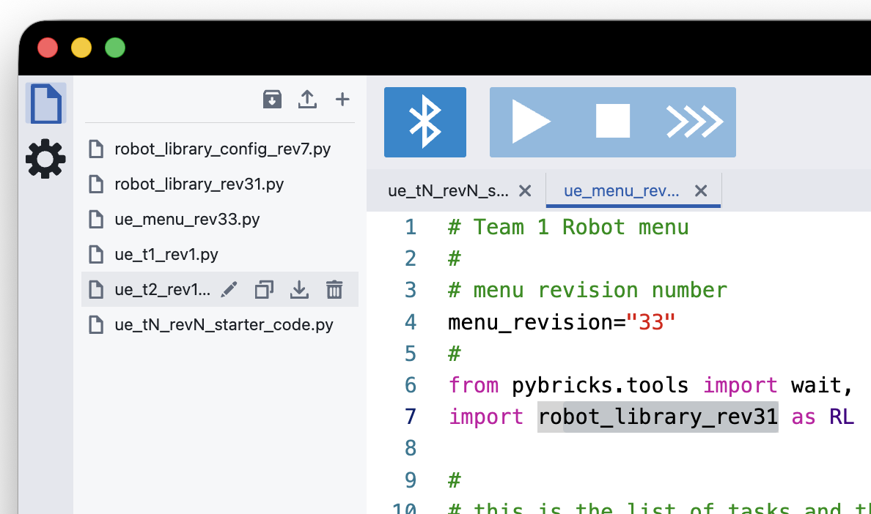
Pybricks User Interface (UI)
Import (upload) a file into the app
Back up all the files in the app to disk. Places them a zip file with date stamp.
VERY USEFUL!!
Create a new file in the app
Delete a file from inside the app
Rename a file (in app not on disk)
Duplicate a file within the app
Export (download) a file to save to disk

Slide 16
Section 2 - Pybricks Python vs. Block Coding Comparison

Slide 17
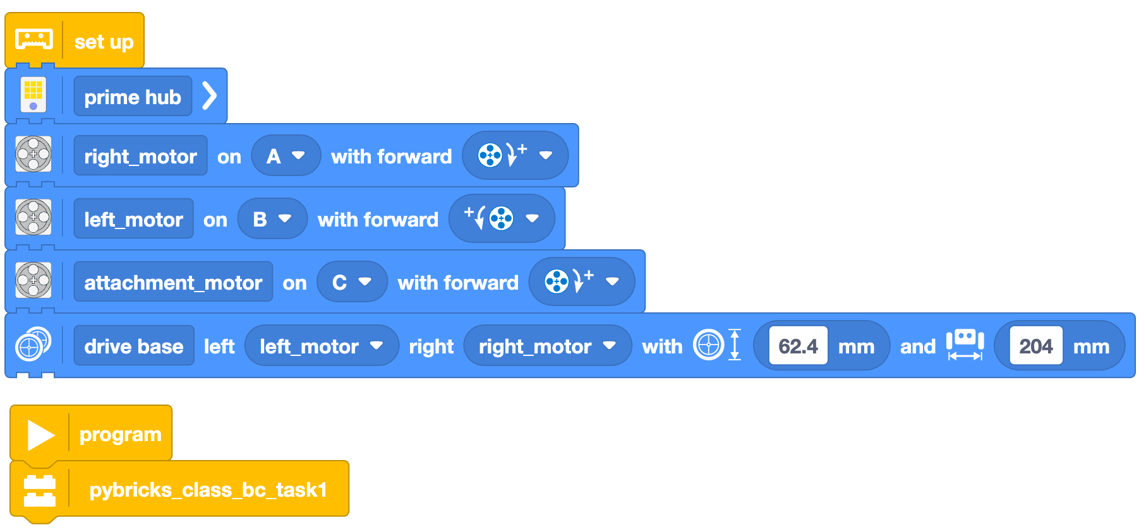
My First Program: Block Code - Initializing the Robot
See slide notes for detailed explanation
Notes:
Initialize the Prime Hub
Initialize 3 motors (right_motor, left_motor, attachment_motor).
Since left and & motors are opposite of each other, you need make the “forward wheel directions” opposite
Configure the “Drive Base” object so it knows which motors are for driving (left_motor & right_motor), what size wheels you are using, and how far the center of wheels are part
The “Drive Base” object is how to control driving speed, driving acceleration, turn speed, turn acceleration, enable the gyroscope, and others aspects of the robot
Create the “main” program
The main program called the “pybricks_class_bc_task1” function

Slide 18
My First Program: Python - Initializing the Robot
from pybricks.hubs import PrimeHub
from pybricks.parameters import Direction, Port, Stop
from pybricks.pupdevices import Motor
from pybricks.robotics import DriveBase
# Set up all devices.
prime_hub = PrimeHub()
right_motor = Motor(Port.A, Direction.CLOCKWISE)
left_motor = Motor(Port.B, Direction.COUNTERCLOCKWISE)
attachment_motor = Motor(Port.C, Direction.CLOCKWISE)
drive_base = DriveBase(left_motor, right_motor, 62.4, 204)
See slide notes for detailed explanation
Notes:
Initialize the Prime Hub
Initialize 3 motors (right_motor, left_motor, attachment_motor).
Since left and & motors are opposite of each other, you need make the “forward wheel directions” opposite
Configure the “Drive Base” object so it knows which motors are for driving (left_motor & right_motor), what size wheels you are using (62.4mm) , and how far the center of wheels are part (204mm)
The “Drive Base” object is how to control driving speed, driving acceleration, turn speed, turn acceleration, enable the gyroscope, and others aspects of the robot

Slide 19
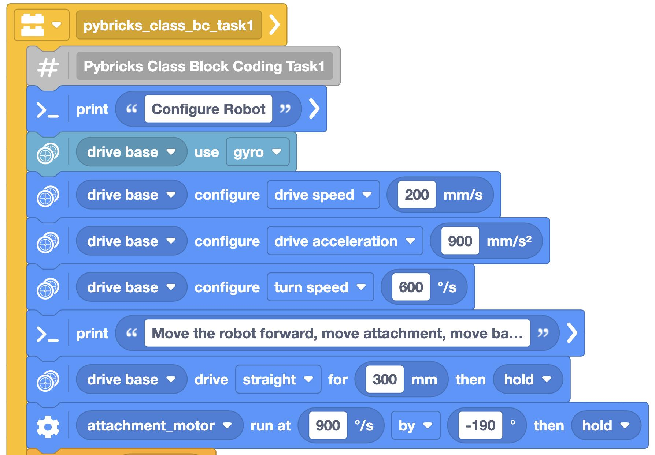
My First Program: Block Code - Do something useful Part 1
See slide notes for detailed explanation
Notes:
Enter a comment
Print a message about configuring the robot
Enable the Gyroscope
Configure “drive base” speed (mm/s) and acceleration (mm/s²) and Turn Speed (degrees/s)
Print a message
Drive straight 300mm then hold position
Move attachment down by 190 degrees (note the NEGATIVE sign) at 900 degrees/second then hold attachment at that position
Whether the direction is positive or negative depends on the orientation of motor relative to the bottom of the robot.

Slide 20
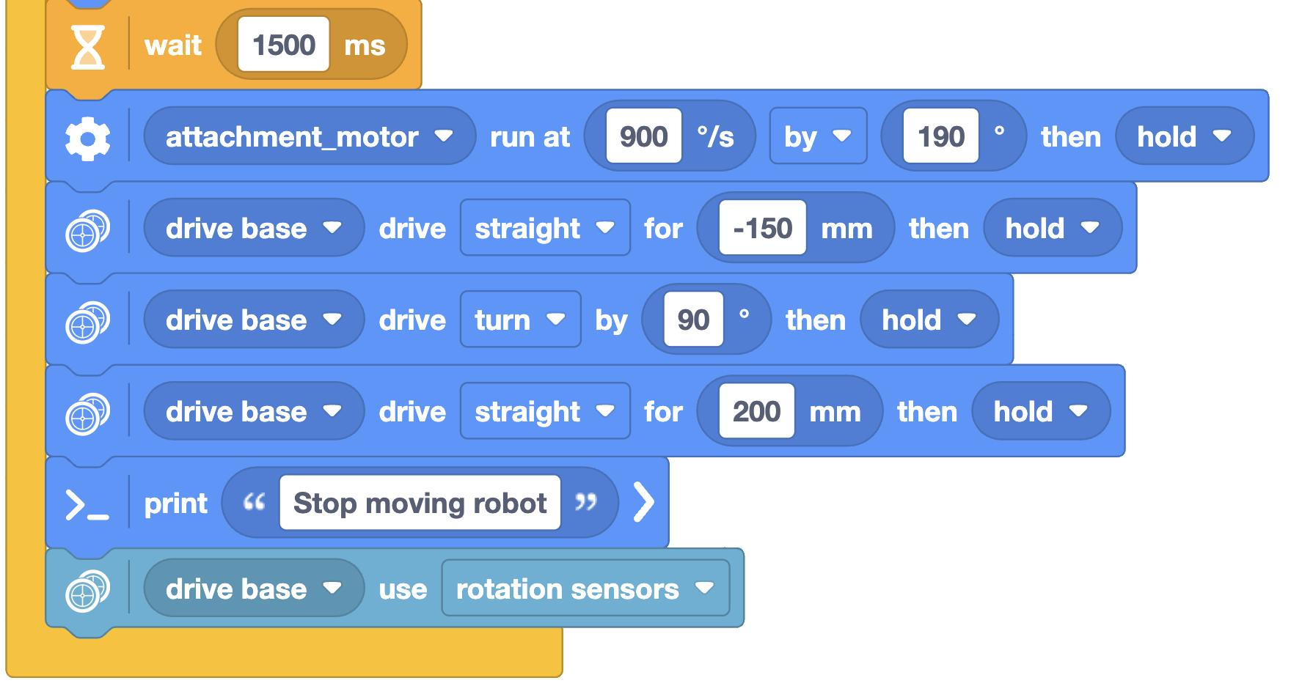
My First Program: Block Code - Do something useful Part 2
See slide notes for detailed explanation
Notes:
Wait 1.5 seconds (1500 milliseconds)
Lift move attachment up by 190 degrees at 900 degrees/second then hold attachment at that position
Drive backwards 150mm (note negative sign)
Turn right by 90 degrees
Drive forwards 200 mm
Print another message
Disable gyroscope (by setting drive base to rotation sensors)

Slide 21
My First Program: Python
def pybricks_class_bc_task1():
# Pybricks Class Block Coding Task1
print('Configure Robot')
drive_base.use_gyro(True)
drive_base.settings(straight_speed=200)
drive_base.settings(straight_acceleration=900)
drive_base.settings(turn_rate=600)
print('Move the robot forward, move attachment, move back, and turn')
drive_base.straight(300)
attachment_motor.run_angle(900, -190)
wait(1500)
attachment_motor.run_angle(900, 190)
drive_base.straight(-150)
drive_base.turn(90)
drive_base.straight(200)
print('Stop moving robot')
drive_base.use_gyro(False)
# The main program starts here.
pybricks_class_bc_task1()
See slide notes for detailed explanation
Notes:
Create the “main” program
The main program called the “pybricks_class_bc_task1” function
Enable the Gyroscope
Configure “drive base” speed (mm/s), acceleration (mm/s²), and “drive base” turn rate
Print a message
Drive straight forward for 250mm
Move attachment at speed of 900 deg/sec by -190 degrees (down for my robot) then hold
Move attachment at speed of 900 deg/sec by 190 degrees (up for my robot) then hold
Drive straight backward for 150mm (-150)
Turn 90 degrees to right
Drive straight forward for 200mm
Print a 2nd message
Disable the Gyroscope
Run the pybricks_class_bc_task1() function
run_task() is not needed in this case since multi-task (e.g., multitaskis not being done. Which is also why await isn’t needed

Slide 22
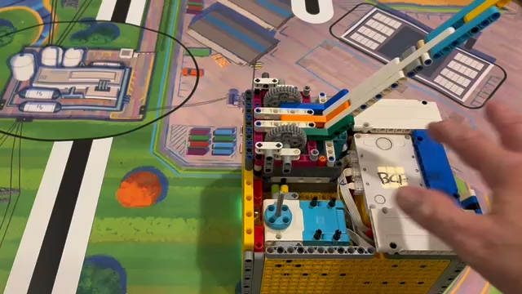
Example Running

Slide 23
Blocking Coding vs. Python (1/2)
Most of the core functionality of Pybricks Python is available in Block Code
Block Code will generate Python “on-the-fly” as blocks are placed, moved, and removed
When saving block code to disk, there is a comment line (#) at the beginning of the file.
  DO NOT edit it or Pybricks will not be able to read the block code file

Slide 24
Blocking Coding vs. Python (2/2)
Due to how block coding mode structures the file it does not work easily with hub_menu() but does work with Slots
  Basically you can only run the task once - which will cause problems in FLL competition if the robot glitches and you need to rerun the task
Block Coding is best used as a transition from Scratch like coding to Python
It can also be used to rapidly test out ideas for missions and tasks then save the file, remove the comment line, and then switch over to straight Python files for competition

Slide 25
More Examples
The next two examples demonstrate how use multitasking and variables in block coding and Python
The two Python examples have been modified to use a simple robot library so they can be used to demonstrate how to use hub_menu(). The core logic is the same as the block code.

Slide 26
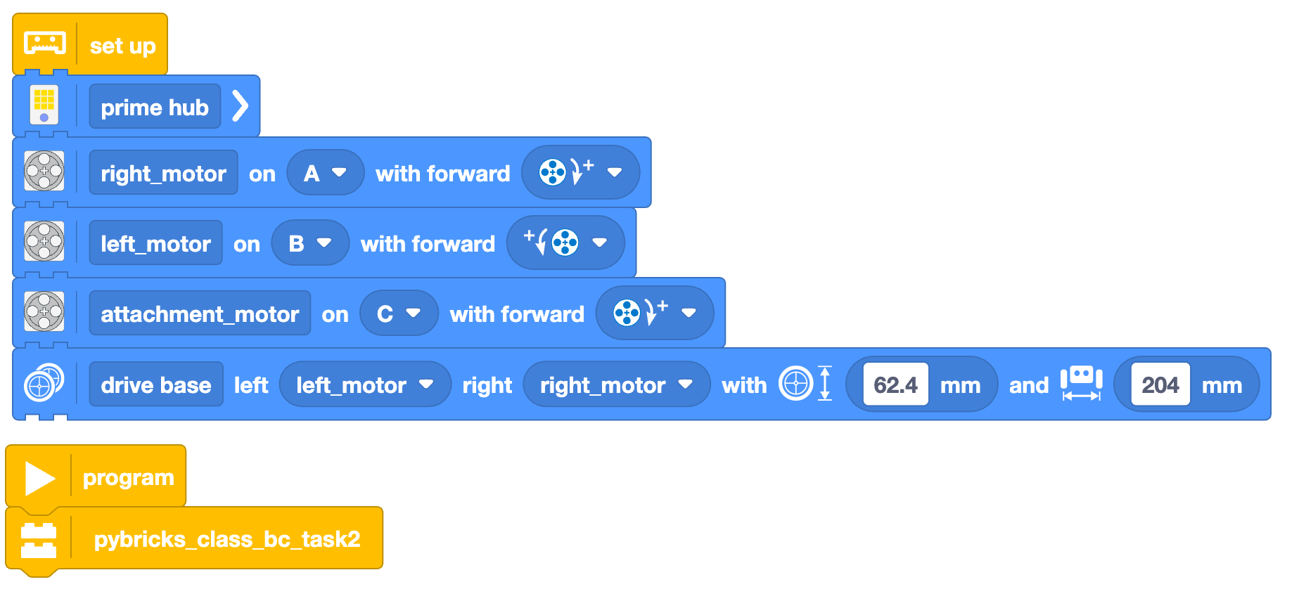
pybricks_class_bc_task2(): Part 1

Slide 27
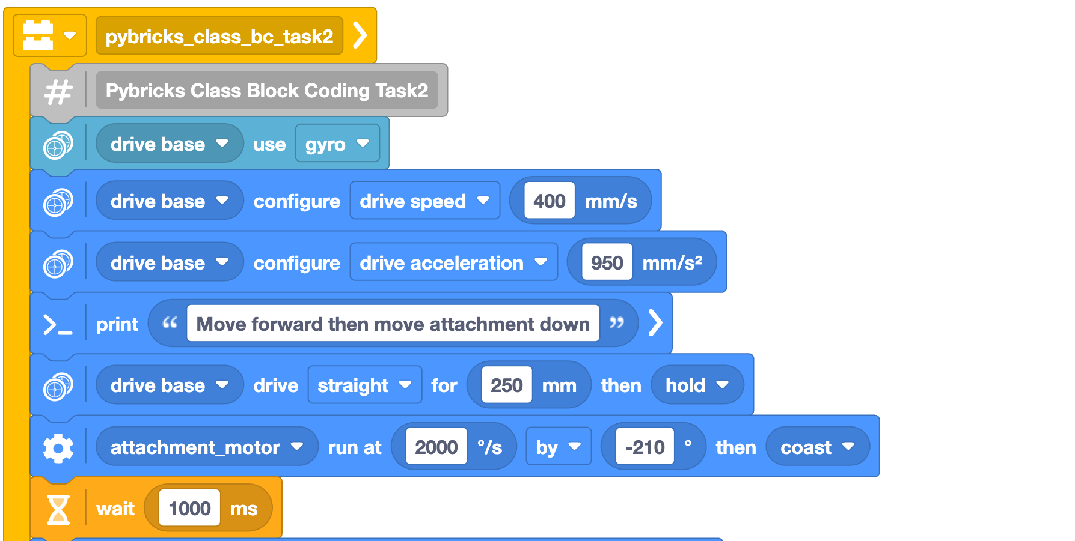
pybricks_class_bc_task2(): Part 2

Slide 28
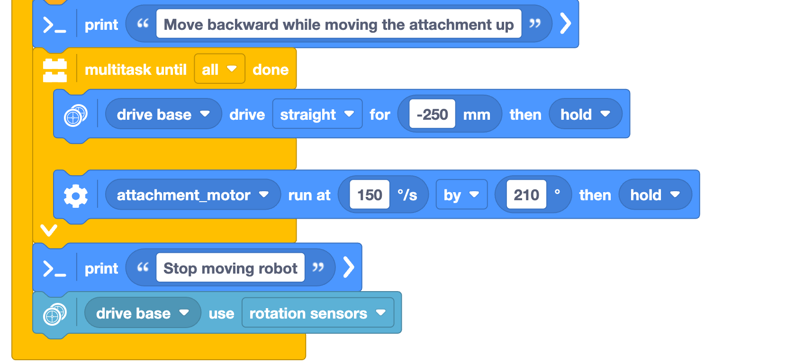
pybricks_class_bc_task2(): Part 3
Multitask code section

Slide 29
pybricks_class_basic_task2()
# Pybricks Class Task 2
from pybricks_class_small_lib_rev3 import *
async def pybricks_class_task2():
# Pybricks Class Block Coding Task2
print("Running Pybricks Class Task 2")
drive_base.use_gyro(True)
drive_base.settings(straight_speed=400,straight_acceleration=950)
print('Move forward then move attachment down')
await drive_base.straight(250)
await attachment_motor.run_angle(2000, -210, Stop.COAST)
await wait(1000)
print('Move backward while moving the attachment up')
await multitask(
drive_base.straight(-250),
attachment_motor.run_angle(150, 210)
)
print('Stop moving robot')
drive_base.use_gyro(False)
#run_task(pybricks_class_task2())
Multitask code

Slide 30
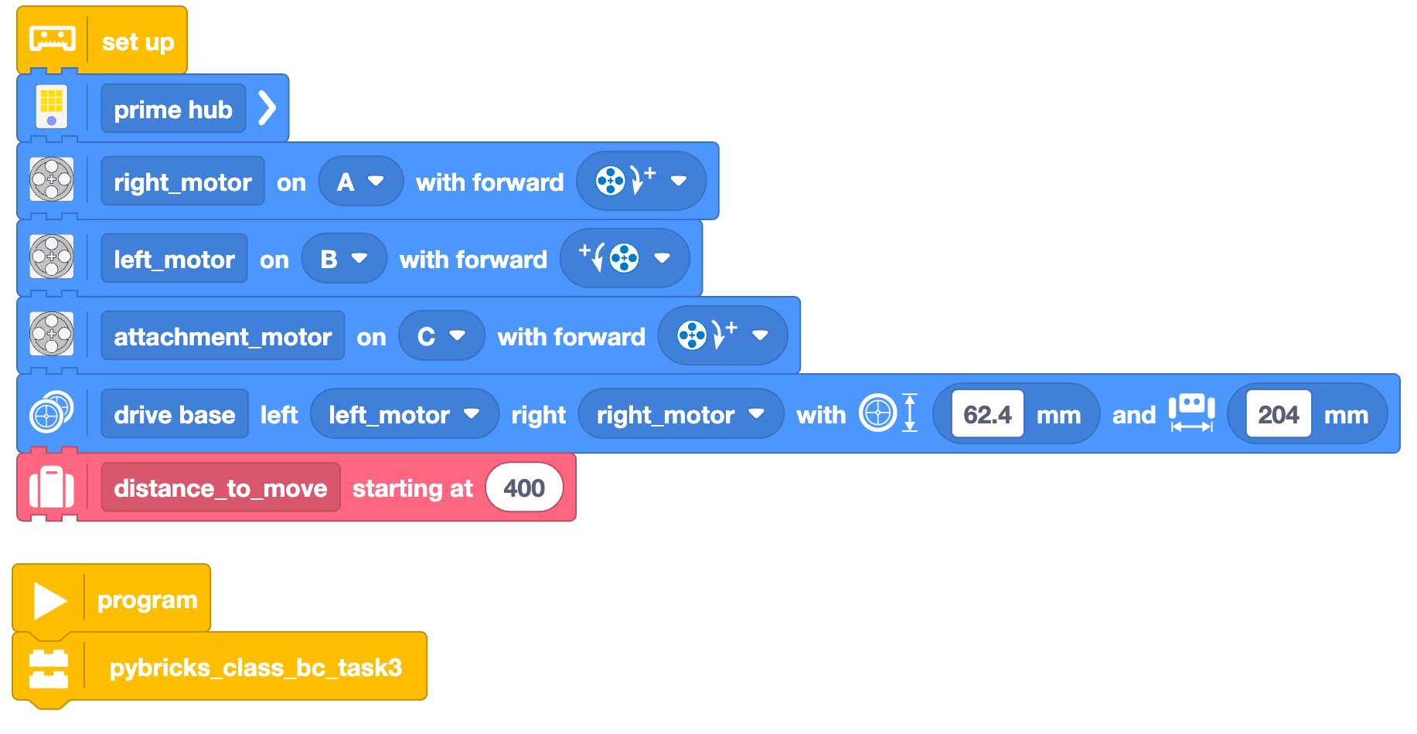
pybricks_class_bc_task3(): Part 1
Set a variable for how far to move

Slide 31
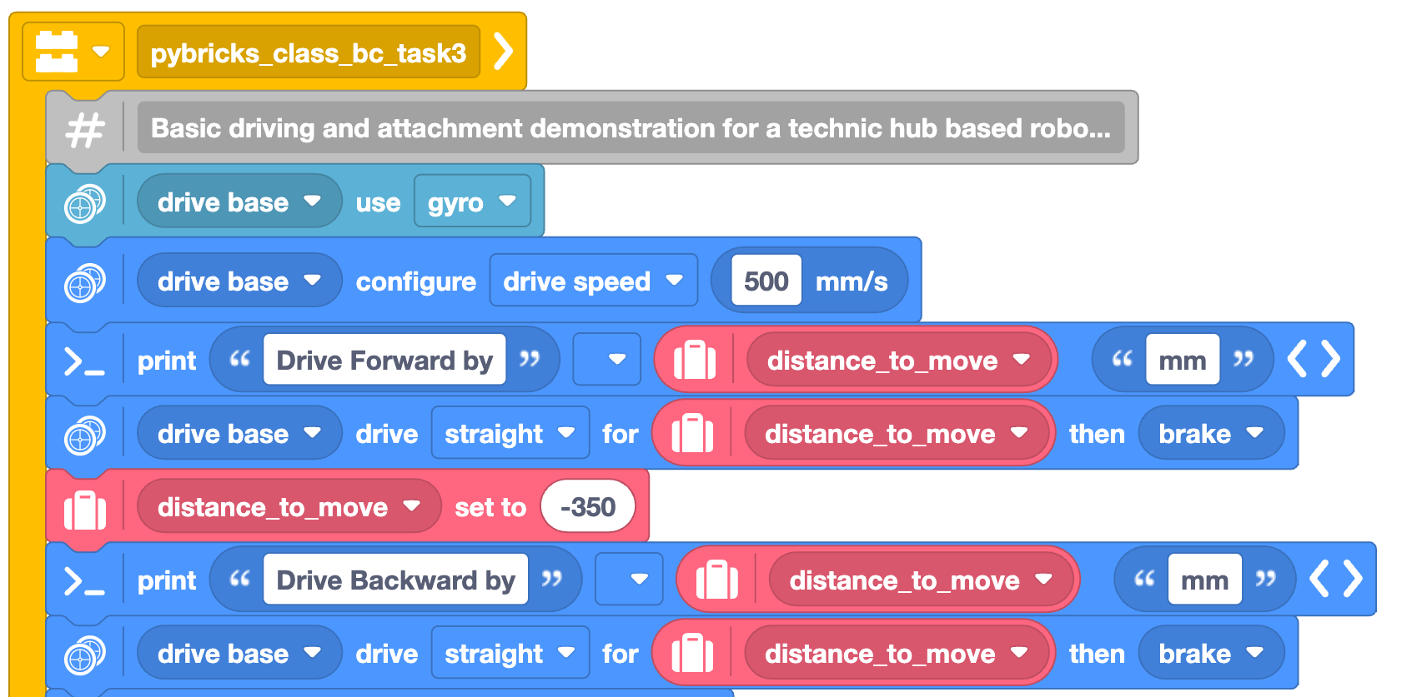
pybricks_class_bc_task3(): Part 2
Use the variable in RED ovals
Changed value of variable

Slide 32
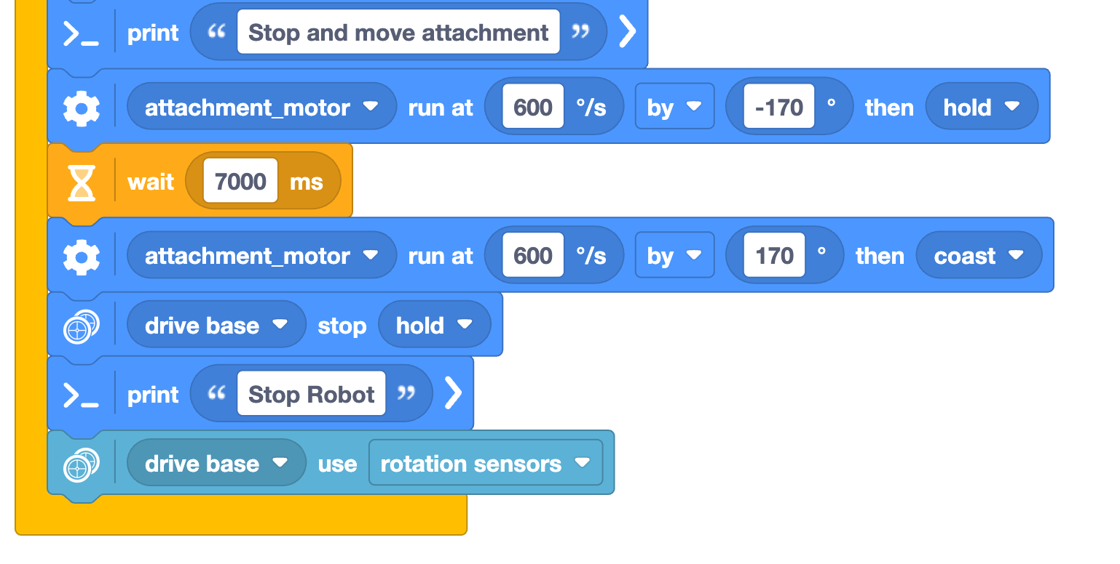
pybricks_class_bc_task3(): Part 3

Slide 33
pybricks_class_basic_task3()
# Pybricks Class Task 3
from pybricks_class_small_lib_rev3 import *
async def pybricks_class_task3():
# Pybricks Class Block Coding Task3
print("Running Pybricks Class Task 3")
distance_to_move = 400
drive_base.settings(straight_speed=200, straight_acceleration=600)
print('Drive Forward by', distance_to_move, 'mm')
await drive_base.straight(distance_to_move, then=Stop.BRAKE)
distance_to_move = -350
print('Drive Backward by', distance_to_move, 'mm')
await drive_base.straight(distance_to_move, then=Stop.BRAKE)
print('Stop and move attachment')
attachment_motor.control.limits(speed=950,acceleration=950)
print('Stop Robot')
drive_base.use_gyro(False)
#run_task(pybricks_class_task3())
Importing our library
Setting the variable
Examples of using it
Changed value of variable

Slide 34
Section 3 – How to use hub_menu()

Slide 35
Hub Menu or “how do I store and run multiple tasks on my robot”
In the previous “My First Program” example (BC & Python) and Tasks 2 and 3 (BC version), the program being loaded will be the only program on the robot
Lego Spike robots can store multiple programs
During competition the team will want to store their tasks as individual programs and be able to use the hub menu to select the task
The hub_menu() function is used to configure the robot for multiple tasks
  Use with Pybricks Block Coding is not straightforward and has limitations

Slide 36
Using hub_menu() (1/2)
hub_menu() should be its own dedicated task
  It should be in its own file in the Pybricks user interface
The robot setup in “Initializing the Robot” slide above should be moved to a separate “library”
  Ex: pybricks_class_library_rev1.py
  This is necessary to prevent Python from trying to create more than one instance of the Prime Hub
In Pybricks, when you press the Play Button while in the hub_menu() code and it will push code for the library and all the tasks used the hub_menu() to the robot
  The reason is due to the import statements at the beginning of of the hub_menu() program

Slide 37
Using hub_menu() (2/2)
Each task’s Python file must have:
  A unique name for the task’s main function:
    Ex: pybricks_class_basic_task1()
  The run_task(pybricks_class_basic_task1)must be commented out if you want to run the task via hub_menu()
    Ex: #run_task(pybricks_class_basic_task1)
  Each task needs to import the library at the top of the file
    Ex: from pybricks_class_basic_lib_rev1 import *
The following hub_menu() example is for the Python code not the Block Code

Slide 38
pybricks_class_basic_task1() – Revised for hub_menu()
# Pybricks Class Task 1
from pybricks_class_basic_lib_rev1 import *
def pybricks_class_basic_task1():
# Pybricks Class Block Coding Task1
print("Running Pybricks Class Task 1")
print('Configure Robot')
drive_base.use_gyro(True)
drive_base.settings(straight_speed=200)
drive_base.settings(straight_acceleration=900)
drive_base.settings(turn_rate=600)
print('Move the robot forward, move attachment, move back, and turn')
drive_base.straight(300)
attachment_motor.run_angle(900, -190)
wait(1500)
attachment_motor.run_angle(900, 190)
drive_base.straight(-150)
drive_base.turn(90)
drive_base.straight(200)
print('Stop moving robot')
drive_base.use_gyro(False)
#run_task(pybricks_class_task1())

Slide 39
Basic Robot Library (pybricks_class_basic_lib_rev1.py)
from pybricks.hubs import PrimeHub
from pybricks.pupdevices import Motor, ColorSensor, UltrasonicSensor, ForceSensor
from pybricks.parameters import Button, Color, Direction, Port, Side, Stop
from pybricks.robotics import DriveBase
from pybricks.tools import wait, StopWatch, multitask, run_task, hub_menu
# Set up all devices.
prime_hub = PrimeHub()
right_motor = Motor(Port.A, Direction.CLOCKWISE)
left_motor = Motor(Port.B, Direction.COUNTERCLOCKWISE)
attachment_motor = Motor(Port.C, Direction.CLOCKWISE)
drive_base = DriveBase(left_motor, right_motor, 62.4, 204)
Load all Pybricks functions you will need
Initialize the Hub, Motors, and DriveBase
This library is imported into the hub_menu() task and the each of three robot mission tasks
It instantiates the PrimeHub, 3 Motors, and DriveBase objects so they can be used by hub_menu() and the three mission tasks
The objects represent the hardware so if you try to instantiate them more than once, you will get an error

Slide 40
hub_menu() Example Part 1 (pybricks_class_basic_menu_rev3.py)
# Pybricks Class Menu
# menu revision number
menu_revision="3"
#
# import necessary libraries and functions
from pybricks_class_small_lib_rev3 import *
print("Robot Menu, rev#",menu_revision)
print("Load Task1")
from pybricks_class_task1_rev3 import pybricks_class_task1
print("Load Task2")
from pybricks_class_task2_rev3 import pybricks_class_task2
print("Load Task3")
from pybricks_class_task3_rev3 import pybricks_class_task3
Importing our library
Import each of the 3 robot tasks into the hub_menu() so it can call (run) them
Notes:
Set the revision number of the menu. This is displayed later and helps with configuration management
Import the library we created
Print out the menu revision number
Import your tasks and their main functions (pybricks_class_task1, pybricks_class_task2, pybricks_class_task3).
Note the _rev# numbers for the tasks. We recommend getting the team members to save changes to their code with increasing revision numbers to the file names. This allows them to “go back in time” to a previous version if they later realize their changes didn’t work out.
We also also recommend putting revision numbers in the code and displaying via print statement when run. See backup slides
Using a revision control system like git also work but that requires a coach with considerably more technical knowledge

Slide 41
hub_menu() Example Part 2
Run this loop forever
print("Running Hub Menu")
while True:
selected = hub_menu("M","1","2","3","X")
try:
if selected == "M":
# does nothing. used to show menu is active
break
if selected == "1":
print("Task 1 Selected")
wait(1000)
run_task(pybricks_class_task1())
elif selected == "2":
print("Task 2 Selected")
wait(1000)
run_task(pybricks_class_task2())
elif selected == "3":
print("Task 3 Selected")
wait(1000)
run_task(pybricks_class_task3())
elif selected == "X":
# does nothing used to show end of menu
break
except BaseException as menuException:
print("Stop was Pressed or a Critical Error Occurred.")
print(menuException)
break
Set the characters that will be displayed on the hub menu.
’M’ is used to show the menu is active
Each number is associated with a task
‘X’ is used to indicate end of the menu
Run each mission task if the right number on the hub menu (1,2, or 3) is selected
wait(1000) is a 1 sec delay so fingers can get out of the way before the robot starts moving
Notes:
Start a while loop that runs forever since its conditional is set permanently to True
Tell the hub what the hub_menu and the possible values for the menu M, 1,2,3, and X
Assigned the values to actions using IF and ELIF (else if) statements
The actions are the name of functions for your different robot tasks (3 in this case)
Add exception (error) handling to exit the hub while loop is something goes wrong

Slide 42
hub_menu() Example: Part 1
# Pybricks Class Menu
# menu revision number
menu_revision="1"
#
# import our library
from pybricks.tools import hub_menu
from pybricks_class_library_rev1 import *
# The name of each task file minus the .py file extension
from pybricks_class_task1_rev1 import pybricks_class_task1
from pybricks_class_task2_rev1 import pybricks_class_task2
from pybricks_class_task3_rev1 import pybricks_class_task3
print("Robot Menu, rev#",menu_revision)
See slide notes for detailed explanation
This hub_menu example is intended to work with the Pybricks Python Examples below.

Slide 43
hub_menu() Example: Part 2
This is
while True:
selected = hub_menu("M","1","2","3","X")
try:
if selected == "M":
# does nothing, used to show menu is active
break
if selected == "1":
wait(1000)
run_task(pybricks_class_task1())
elif selected == "2":
wait(1000)
run_task(pybricks_class_task2())
elif selected == "3":
wait(1000)
run_task(pybricks_class_task3())
elif selected == "X":
# does nothing, used to show end of menu
break
except BaseException as menuException:
print("Stop was Pressed or a Critical Error Occurred")
print(menuException)
break
See slide notes for detailed explanation
This hub_menu example is intended to work with the Pybricks Python examples above.
Notes:
Start a while loop that runs forever since its conditional is set permanently to True
Tell the hub what the hub_menu and the possible values
Assigned the values to actions
Actions is the name of functions for your different robot tasks (3 in this case)
Add exception (error) handling to exit the hub while loop is something goes wrong
The source code to the pybricks_class_task#() tasks are in the backup slides in the Pybricks Python Examples section

Slide 44
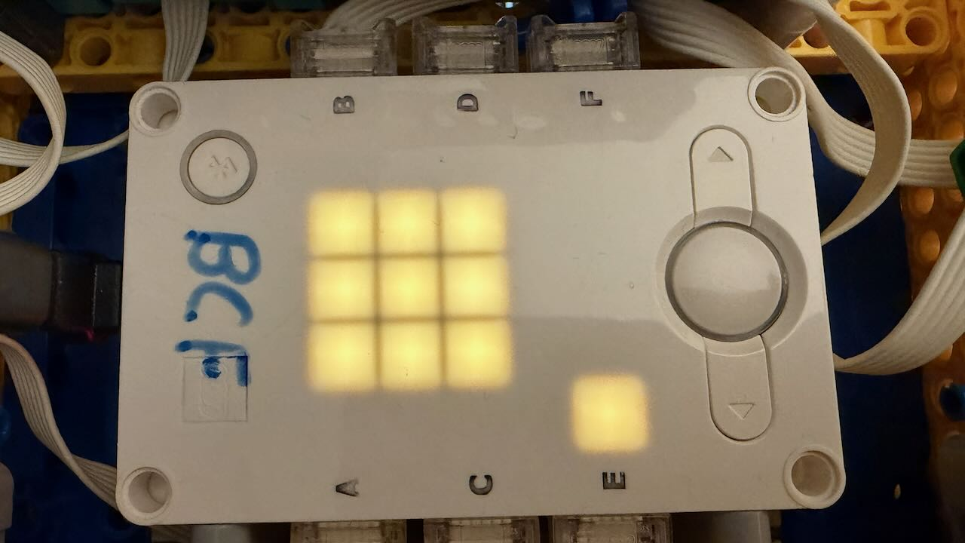
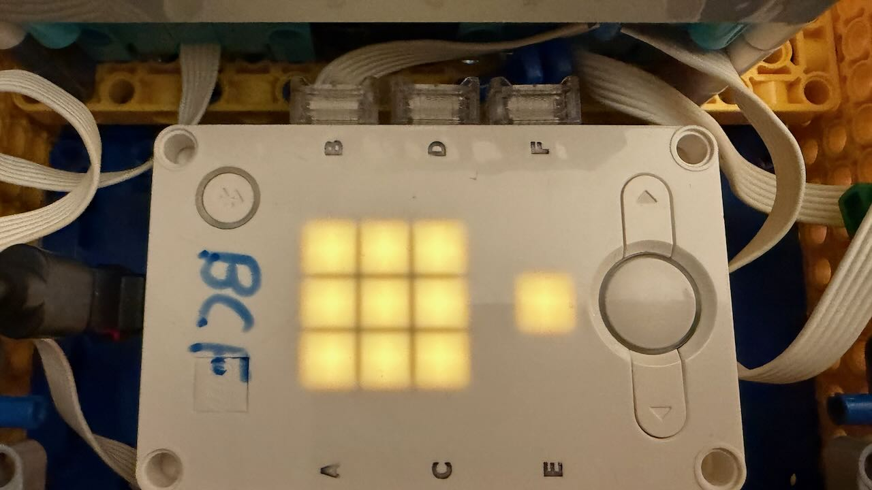
Running Multi Programs – Option 2
As of Pybricks Code v3.0.1 with firmware v4.0.1, there is new multi-program feature
It is called Slots and 5 are avalable
By default, each slot can run one program
However, you can run a separate hub_menu() in each slot
Intended to solve the ability to run multiple Block Code based programs on a robot

Slide 45
Section 4 – Overview of Core Pybricks Python Functions

Slide 46
Introduction to Pybricks Functions
Pybricks provides excellent documentation and examples and should be considered the authoritative source for information
However, there are a large number of commands
Most are not needed to be effective in solving FLL missions
The next set of slides covers the commands we use in our robots
Not all features of all commands are covered
When in doubt use the official Pybricks documentation
The following slides include a combination of the official Pybricks documentation with additions/clarifications

Slide 47
Components of a Pybricks program
Pybricks Programs usually consist of the following parts (in order):
Import Pybricks Libraries
  The python command important libraries and functions from for use by our program
  Ex: from pybricks.hubs import PrimeHub
Import any support libraries the team wrote that you need
Create any support functions that you need for the new task
Create the ”main” function, usually named after the task
  Ex: submerged_task1()
Add run_task() at end of program which is used to execute your “main” function on the robot
  Ex: run_task(submerged_task1())
  Note: Putting run_task()in your task’s code is normally not done when hub_menu()is being used. You use a comment (#) at the beginning of the line to disable it when using hub_menu().

Slide 48
await()
For any Pybricks command that takes time to complete before moving on to the next command you must prepend with await
  Used before nearly all commands to the robot that result in the robot actually doing something (e.g., moving a motor, reading a sensor, making beeps) and all commands involving a time element
In the Pybricks documentation, if await precedes the command then it must be used with await
Failure to do this will result in incorrect and unpredictable behavior with the robot
Notes:
Analogy: Imagine two dogs racing to their owner, depending on which dogs wins, different things happen.

Slide 49
Pybricks Multitasking
Pybricks supports running multiple functions concurrently
  Pybricks uses the term “coroutine” which also called a function
Any Pybricks command that is prefixed with await can be used in multitasking and await must be used with the command or the results will be indeterminate
run_task(function_name) is used to run one of your functions
from start to end while blocking all other functions
  When using hub_menu() the run_task() in your tasks should be commented out (put a # at the beginning of the line)
multitask(function_name1, function_name2, function_nameN) is used to run multiple functions at at time
  By default, multitask()waits for all functions to complete
  If you add the race=True parameter, multitask() will wait until one function completes and then it will stop the rest
Notes:
For more details see:
https://github.com/orgs/pybricks/discussions/1721

Slide 50
Miscellaneous Tidbits
Positive/Negative integers are used to move forward/backward for distance, angles, and up/down for attachments
  But the orientation of the motor determines if positive is forward or backward
Attachments should have a defined AND consistent start position
  Teams should be encouraged to always verify the attachments’ start position for each run
  Our teams ”wiggle” each attachment forward/backward and then set it in the start position for each run

Slide 51
Motor()
Motor(port, positive_direction=direction, gears=None or [list of gears], reset_angle=True|False, profile=None)
Where direction is Direction.CLOCKWISE or Direction.COUNTERCLOCKWISE
Gears is the list of gears linked to the motor. The gear connected to the motor comes first and the gear connected to the output comes last.
Gears are represented by number of teeth. So [12,36] would be a 12-tooth gear connected to a 36-tooth gear. Gears are primarily used in attachments.
Normally you have two drive motors, one must be moving COUNTERCLOCKWISE and the other CLOCKWISE
  By default motors move CLOCKWISE
  You can use +/- in the angle in commands like run_target() to change the direction
Motor() has a number of functions associated with it.
Motor.stalled() function is used to determine if a motor (usually an attachment has gotten stuck

Slide 52
Motor() Examples
leftMotor = Motor(LeftDriveMotorPort, Direction.COUNTERCLOCKWISE, reset_angle=True)
rightMotor = Motor(RightDriveMotorPort,Direction.CLOCKWISE, reset_angle=True)
leftAttachment = Motor(LeftAttachmentMotorPort, Direction.CLOCKWISE, reset_angle=True)
  if leftAttachment.stalled() == True then doing something about it..

Slide 53
DriveBase()
DriveBase(left_motor, right_motor, wheel_diameter, axle_track)
left_motor (Motor) – The motor that drives the left wheel, use Motor() to create the left_motor object
right_motor (Motor) – The motor that drives the right wheel, use Motor() to create the left_motor object
wheel_diameter (Number, mm) – Diameter of the wheels.
axle_track (Number, mm) – Distance between the points where both wheels touch the ground.
Used to control the drive motors for the robot
IMPORTANT: Review the “Measuring and validating the robot dimensions” section in the DriveBase documentation on how to test and tweak the wheel_diameter and axle_track settings

Slide 54
DriveBase()Functions
DriveBase.settings(straight_speed, straight_acceleration, turn_rate, turn_acceleration)
  Used to configure speed, acceleration
  You need to use the DriveBase.Settings() function to set the speed and acceleration values for below arc(), turn(), and straight() functions
DriveBase.use_gryo(Boolean)
  - enables the gryroscope
await DriveBase.arc(radius, angle=None, distance=None, then=Stop.HOLD, wait=True)
  Used to drive in an arc based on degrees or distance
  You can use either Angle or Distance but not both
await DriveBase.turn(angle, then=Stop.HOLD, wait=Blooean)
  Used to turn the robot a specific number of degrees
await DriveBase.straight(dist, then=Stop.HOLD, wait=True)
  Used to drive straight in mm
Distances and Angles can be Positive (right) or Negative (left) – unless your hub is situated differently, then Pos/Neg might be opposite

Slide 55
DriveBase()Examples
driveBase = DriveBase(leftMotor,rightMotor, wheel_diameter=62.4, axle_track=204)
driveBase.settings(DefaultStraightSpeed=400, DefaultTurnRate=300 DefaultStraightAcceleration=[500,100], DefaultTurnAcceleration=300)
  Accelerations values are for acceleration and deceleration. This sets the speed at 400 mm/s, turn rate= 300 mm/s, Straight Acceleration at 500 mm/s² and Deceleration at 100 mm/s², both turn accelerations at 300 mm/s².
To drive straight for 1000mm slowly
  driveBase.settings(straight_speed=100, straight_acceleration=100)
  await driveBase.straight(1000 ,then=Stop.HOLD, wait=True)

Slide 56
Gyroscope
The gyroscope (gyro for short) sensor on the hub is used to provide automatic real-time corrections to bumps and anomalies on the course
To enable (turn-on) the gyro use: driveBase.use_gyro(True)
To disable (turn-off) the gyro use: driveBase.use_gyro(False)
ALWAYS remember to disable the gryo after every mission
  Failure to do so could be catastrophic in the Robot Game and would require turning off the robot
  Simple solution is disable the gyro in hub_menu()
  Ideally create a function that stops the gyro and stops all the robot motors
Remember to enable the gyro at the start of the mission, some missions might require the gyro to be disabled

Slide 57
Motor.run_target()
await run_target(speed, target_angle, then=Stop.HOLD, wait=True)
  Runs the motor at a constant speed towards a given target angle.
  The direction of rotation is automatically selected based on the target angle. It does not matter if speed is positive or negative.
  speed (Number, deg/s) – Speed of the motor.
  target_angle (Number, deg) – Angle that the motor should rotate to.
  then (Stop) – What to do after coming to a standstill.
  wait (bool) – Wait for the motor to reach the target before continuing with the rest of the program.
  run_target is commonly used for attachments to provide precise control over the how far it moves

Slide 58
then=Stop.????
Used to the control the end condition of a motor
Multiple Pybricks commands have the then=Stop.???? argument
In FLL it is typically used for attachment motors to control whether or not they hold their position.
  For example, if you want to lift an object and carry it to a different location, the Stop.HOLD would be used to hold the attachment off the mat. If you used Stop.COAST or Stop.BRAKE the attachment will not stay in position.
Valid values are:
  Stop.COAST
    Let the motor move freely.
  Stop.COAST_SMART
    Let the motor move freely. For the next relative angle maneuver, take the last target angle (instead of the current angle) as the new starting point. This reduces cumulative errors. This will apply only if the current angle is less than twice the configured position tolerance.
  Stop.BRAKE
    Passively resist small external forces.
  Stop.HOLD
    Keep controlling the motor to hold it at the commanded angle.
  Stop.NONE
    Do not decelerate when approaching the target position. This can be used to concatenate multiple motor or drive base maneuvers without stopping. If no further commands are given, the motor will proceed to run indefinitely at the given speed.

Slide 59
Motor.run_target()Examples
await multitask(attachment.run_target(250,190, then=Stop.COAST), isStalled(attachment),race=True)
  Moves an attachment at 250 mm/s by 190 degrees then coasts the attachment at that position while moving the attachment it is also checking to see if the attachment motor has stalled. If it stalls it stops. If stall detection wasn’t used it could lock the robot.
  For example, in the Submerged season the team used this approach when using an attachment to release the shark in Mission 2 and flipping the coral reef in Mission 3. Without stall detect the attachment would frequently stall locking the robot in position.
await attachment.run_target(250,120, then=stop.HOLD, wait=True)
  Moves an attachment motor at 250 mm/s by 100 degrees then holds the attachment at that position (“floating” in the air)

Slide 60
Section 5 – Building & Using a Pybricks Robot Library

Slide 61
Why a Robot Library?
“I thought you said Pybricks is easy to learn and use….”
It is...but kids end up repeatedly using the same sequence of commands over and over but just with different values
A Robot Library:
  Allows students to focus on solving the robot missions
  Combines multiple functions (e.g., steps) into a single step
  Enables easier debugging of robot programs
  Simplifies the robot control into English like phrases that are easy for kids to understand

Slide 62
Why a Robot Library?
The robot library combines those commands into functions, which:
  Reduces errors of manually reusing the same block of code over and over
  Provides a mechanism to embed configurable debugging (diagnostic) statements that can be displayed when testing
  Supports code reuse which is a major programming principle
  Allows changes to the underlying implementation without (necessarily) changing how it is used
    For example: to improve debugging functionally, to enable step-by-step execution, to improve error condition handing, to improve performance, improve input validation
Teaches and enforces the concept and value of code reuse

Slide 63
Changes from Actual Code
The code examples in these slides differ slightly from the actual code
Comments may have been removed so the code could fit on the slide
Whitespace (spaces/tabs) has been changed to so the code could fit on the slide. So indentations are likely wrong.
Some debugging statements may have been removed to improve readability
This particular robot library does NOT make use of light sensor. It only uses the sensors on the Lego Spike Prime Hub.

Slide 64
Support Functions
initializeRobot()
  Configures the robot
stopEverything()
  Disables the Gyroscope and stops the motors
initializeRobotForTask()
  Called at the beginning of each task to set the robot
isStalled(attachment)
  Internal function to detect if an attachment has got stuck, not directly called by users of library

Slide 65
Movement Functions (1/2)
driveRobot(dist, speed, accel)
  Drive robot forward or backward at a specific speed and acceleration
driveRobotAndLift(dist, accel, attachmentStr, degrees, aSpeed, stopMode, resetAngle, stallDetect)
  Drive robot forward or backward while lifting an attachment up or down
turnRobot(dir, turnAccel, turnRate)
  Turn robot in a specific direction at a specific speed (rate) and acceleration
turnRobotAndLift(dir, turnAccel, turnRate, attachmentStr, degrees, aSpeed, stopMode, resetAngle, stallDetect)
  Turn robot while lifting up or down while lifting an attachment up or down

Slide 66
Movement Functions (2/2)
driveRobotInArc(radius, mode, angleOrDist, speed, accel, turnAccel, turnRate)
  Drive robot forward or backward in arc for a specific angle or distance at a specific speed, acceleration, and turn rate
driveRobotInArcAndLift(radius,mode, angleOrDist, attachmentStr, degrees, aSpeed, stopMode, resetAngle, stallDetect)
  Drive robot forward or backward in arc for a specific angle or distance at a specific speed, acceleration, and turn rate while lifting an attachment up or down
moveAttachment(attachmentStr, degrees, speed, stopMode, resetAngle, stallDetect)
  Move an attachment by a specified number of degrees at specific speed with optional stall detection

Slide 67
Robot Library Header
# Basic FLL Robot Library
#
# This code is released under the Apache License v2.0
# https://www.apache.org/licenses/LICENSE-2.0.txt
# Developed against Pybricks 3.6.1
#
# Update this if you change the code
coreLib_revision="4"
coreLib_date="14 September 2025"
#
#
from pybricks.hubs import PrimeHub
from pybricks.pupdevices import Motor, ColorSensor, UltrasonicSensor, ForceSensor
from pybricks.parameters import Axis, Button, Color, Direction, Port, Side, Stop
from pybricks.robotics import DriveBase
from pybricks.iodevices import XboxController
from pybricks.tools import wait, StopWatch, multitask, run_task, hub_menu
from umath import sin, pi
from pybricks.hubs import PrimeHub
#
# change this for your configuration file
#
# define and set the debug levels
debugL1=True
debugL2=False
Change these when you update the library
This imports the majority of the Pybricks functions you will likely need if your programs.
debugL1
Minimal debug output
We typically use L1 for our robot tasks
debugL2
  Large amount of debug output
Both should be set to False for production (competition)

Slide 68
initializeRobot() (1/4)
def initiatizeRobot():
global hub
global leftAttachment
global leftAttachmentName
global rightAttachment
global rightAttachmentName
global attachmentsPresent
global driveBase
global leftMotor
global rightMotor
global leftDriveMotorPort
global rightDriveMotorPort
global leftAttachmentMotorPort
global rightAttachmentMotorPort
global leftAttachmentHasGears
global rightAttachmentHasGears
# initialize the robot's
hub = PrimeHub()
# print some information about the robot library
if debugL1: print("Basic Robot Library Rev#",coreLib_revision,"Release Date: ",coreLib_date)
if debugL1: print(" Initializing Robot")
if debugL1: print(" Using hub named: ", hub.system.name())
Declare a bunch of variables as global variables so they can be updated in the initializeRobot() function
Initial the Lego Spike Prime hub so that it can be used
Purpose: Initialize the robot by configuring the Prime Hub, DriveBase, drive motors, and attachment motors

Slide 69
initializeRobot() (2/4)
Continued from Previous Slide
# set the hub LED display to the correct orientation
hub.display.orientation(Side.RIGHT) # Side.TOP is the normal value
# set this to true if there are attachments
attachmentsPresent=True
# the port locations for the light sensors, drive motors,
# and attachment motors
LeftDriveMotorPort=Port.B
RightDriveMotorPort=Port.A
RightAttachmentMotorPort=Port.C
LeftAttachmentMotorPort=Port.D
if debugL2: print("DEBUG-L2 - Assigning & Configuring Motors")
leftMotor = Motor(LeftDriveMotorPort, Direction.COUNTERCLOCKWISE,
reset_angle=True)
rightMotor = Motor(RightDriveMotorPort,Direction.CLOCKWISE,
reset_angle=True)
Tells the Prime Hub how the hub is oriented in/on the robot. See Pybricks docs for more detail
Assign the ports on the Prime Hub to the two drive motors and the two attachment motors
Initialize motors. The motor on the left must turn counterclockwise to make the robot go forward.

Slide 70
initializeRobot() (3/4)
Continued from Previous Slide
Initialize the DriveBase and configure wheelDiameter & axleTrack that are specific for your robot!! Both values are in millimeters (mm).
axleTrack is the measurement between the centerpoints of the both wheel treads
The axleTrack & wheelDiameter likely will need to tweaking.
Read the Pybricks doc on DriveBase in the subsection "Measuring and validating the robot dimensions" on how tune these settings
#
# Setup drive base and default performance parameters
if debugL2: print("DEBUG-L2 - Configuring the DriveBase")
wheelDiameter=62.4
axleTrack=204
driveBase = DriveBase(leftMotor,rightMotor, wheel_diameter=wheelDiameter, axle_track=axleTrack)

Slide 71
initializeRobot() (4/4)
Continued from Previous Slide
DefaultStraightSpeed=400
DefaultStraightAcceleration=[500,500]
DefaultTurnAcceleration=[500,500]
DefaultTurnRate=300
if debugL2: print("DEBUG-L2 - Configuring the Speed & Acceleration default settings")
driveBase.settings(straight_speed=DefaultStraightSpeed,
straight_acceleration=DefaultStraightAcceleration,
turn_acceleration=DefaultTurnAcceleration,
turn_rate=DefaultTurnRate)
if attachmentsPresent == True:
if debugL2: print("DEBUG-L2 - Configuring Attachment Motors")
leftAttachment = Motor(LeftAttachmentMotorPort,Direction.CLOCKWISE,reset_angle=True)
rightAttachment = Motor(RightAttachmentMotorPort,Direction.CLOCKWISE,reset_angle=True)
Define some default speed and acceleration motor settings for your drive motors
Actually, configure the DriveBase to use the above settings
Assign and configure the two attachment motors

Slide 72
moveAttachment(attachmentStr, degrees, speed, stopMode,
resetAngle, stallDetect) (1/2)
async def moveAttachment(attachmentStr, degrees, speed, stopMode, resetAngle, stallDetect) -> bool:
if attachmentStr == "left":
attachment=leftAttachment
elif attachmentStr == "right":
attachment=rightAttachment
else:
print("moveAttachment() - ERROR, illegal attachment name of ",attachmentStr)
return False
if resetAngle == True: resetAttachment(attachmentStr)
if stopMode == "hold":
stopMode=Stop.HOLD
elif stopMode == "brake":
stopMode=Stop.BRAKE
elif stopMode == "coast":
stopMode=Stop.COAST
else:
stopMode=Stop.HOLD
(2/2)
Motors have different stop modes.
HOLD is used for picking up and carrying items.
HOLD or BRAKE is good for lifting a lever or object that the robot doesn't have to carry.
COAST is best for levers you have to push down to reduce stall risk.
Purpose: Move an attachment a specific number of degrees, with a configurable stop mode, and optional stall detection. Degrees are relative to the start position of the attachment.

Slide 73
moveAttachment(attachmentStr, degrees, speed, stopMode, resetAngle, stallDetect) (2/2)
Continued from Previous Slide
if (stallDetect == True):
await multitask(attachment.run_target(speed,degrees,then=Stop.HOLD),
isStalled(attachment),race=True)
else:
await attachment.run_target(speed, degrees,
then=stopMode, wait=True)
if debugL2: print("DEBUG-L2 - End moveAttachmentFC() final angle=",topAttachment.angle())
return True
Move the attachment a specific number of degrees while also checking to see if the motor has
stalled using the isStalled() function. When race=True it will run both commands until one finishes then it kills the other one. So if the motor stalls it will kill the run_target() function
Move the attachment a specific number of degrees, then stop using stopMode, and wait for the command to complete
Purpose: Move an attachment a specific number of degrees, with configurable stop mode, and optional stall detection. Degrees are relative to the start position of the attachment.

Slide 74
driveRobot(dist, speed, accel)
# drive robot forward or backward (-negative dist)
async def driveRobot(dist,speed, accel) -> bool :
if debugL2: print("DEBUG-L2 - driveRobot() dist=",dist," speed=", speed," accel=",accel)
# configure the speed and acceleration values
driveBase.settings(straight_speed=speed,
straight_acceleration=accel)
await driveBase.straight(dist, then=Stop.HOLD, wait=True)
if debugL2: print("DEBUG-L2 - driveRobot() done dist travelled=",driveBase.distance())
return True
Set the straight speed and acceleration for the drive motors
Drive forward or backward a specific distance in millimeters, then stop and hold position, and hub will wait till this is done
Purpose: Drive forward or backward a specific speed and acceleration. Direction is based on if distance is negative. Normally a distance negative is backward but this would depend on how the robot is oriented.

Slide 75
driveRobotAndLift(dist, accel, attachmentStr, degrees, aSpeed, stopMode, resetAngle, stallDetect)
async def driveRobotAndLift(dist,dSpeed,accel,attachmentStr,degrees,aSpeed,resetAngle,stallDetect) -> bool:
if attachmentStr == "left":
attachment=leftAttachment
elif attachmentStr == "right":
attachment=rightAttachment
else:
print("driveRobotAndLift() - illegal attachment name of ",attachmentStr)
return False
if debugL2: print("DEBUG-L2 - driveRobotAndLift() dist=",dist," dSpeed=",dSpeed," accel=",accel,”
attach=",attachmentStr," degrees=", degrees," aSpeed=",aSpeed," resetAngle=",
resetAngle," stallDetect=",stallDetect)
await multitask(driveRobot(dist, dSpeed, accel, False),
moveAttachment(attachmentStr, degrees, aSpeed, stopMode,resetAngle,stallDetect))
if debugL2: print("DEBUG-L2 - driveRobotAndLift() done")
return True
Move forward or backward
Move attachment
Purpose: Purpose: Drive forward or backward a specific speed and acceleration while moving an attachment. Normally a negative distance is backward but this would depend on how the robot is oriented.

Slide 76
turnRobot(dir, turnAccel, turnRate)
# turn robot forward or backward (use negative number for
# backward if robot facing forwards). if robot is facing
# backwards, forward is then the negative number
async def turnRobot(dir,turnAccel, turnRate) -> bool :
if debugL2: print("DEBUG-L2 - turnRobot() dir=",dir," turnAccel=",turnAccel," turnRate=",turnRate)
driveBase.settings(turn_acceleration=turnAccel, turn_rate=turnRate)
await driveBase.turn(dir,then=Stop.HOLD,wait=True)
if debugL2: print("DEBUG-L2 - turnRobot() done")
return True
Set the turn acceleration and turn rate for the drive motors
Turn the robot to a specific angle, hold position at end of turn, wait until the turn completes.
Purpose: Turn the robot to a specific angle.

Slide 77
turnRobotAndLift(dir, turnAccel, turnRate, attachmentStr, degrees, aSpeed, stopMode, resetAngle, stallDetect)
async def turnRobotAndLift(dir,turnAccel, turnRate,attachmentStr, ,aSpeed, resetAngle, stallDetect) -> bool:
if attachmentStr == "left":
attachment=leftAttachment
elif attachmentStr == "right":
attachment=rightAttachment
else:
print("turnRobotAndLift() - illegal attachment name of ",attachmentStr)
return False
await multitask(turnRobot(dir,turnAccel, turnRate,False),
moveAttachment(attachmentStr, degrees, aSpeed, stopMode,resetAngle,stallDetect))
return True
Turn robot
Move attachment
Purpose: Turn the robot to a specific angle and move an attachment
Purpose: Turn robot while moving an attachment

Slide 78
driveRobotInArc(radius, mode, angleOrDist, speed, accel, turnAccel, turnRate)
async def driveRobotInArc(radius,mode,angleOrDist,speed,accel,turnAccel,turnRate) -> bool :
driveBase.settings(straight_speed=speed, straight_acceleration=accel,
turn_acceleration=turnAccel,turn_rate=turnRate)
if mode == "arc":
if debugL2: print("DEBUG-L2 - turnRobotInArc() radius=",radius,
" mode=arc degrees=",angleOrDist)
await driveBase.arc(radius,angle=angleOrDist,then=Stop.HOLD,wait=True)
if mode == "distance":
if debugL2: print("DEBUG-L2 - turnRobotInArc() radius=",radius,
" mode=distance distance=",angleOrDist)
await driveBase.arc(radius,distance=angleOrDist,then=Stop.HOLD,wait=True)
if debugL2: print("DEBUG-L2 - turnRobotInArc() done")
return True
Drive the robot in arc by specific number of degrees then stop and hold position
Drive the robot in arc by specific number of millimeters then stop and hold position
Purpose: Drive robot in an Arc based on degrees or distance (mm). Normally a negative angle/distance is backward but this would depend on how the robot is oriented.

Slide 79
driveRobotInArcAndLift(radius,mode, angleOrDist, attachmentStr, degrees, aSpeed, stopMode, resetAngle, stallDetect) (1/2)
async def driveRobotInArcAndLift(radius,mode,angleOrDist,attachmentStr,degrees,aSpeed,resetAngle,stallDetect) -> bool:
if attachmentStr == "left":
attachment=leftAttachment
elif attachmentStr == "right":
attachment=rightAttachment
else:
print("driveRobotInArcAndLift() - illegal attachment name of ",attachmentStr)
return False
if mode == ”angle":
await multitask(driveBase.arc(radius, angle=angleOrDist, then=Stop.HOLD, wait=True),
moveAttachment(attachmentStr, degrees, aSpeed, stopMode,resetAngle,stallDetect))
Drive robot in an Arc based on degrees
Move attachment
Purpose: Drive robot in an arc (by degrees or distance) and move an attachment

Slide 80
driveRobotInArcAndLift(radius,mode, angleOrDist, attachmentStr, degrees, aSpeed, stopMode, resetAngle, stallDetect) (2/2)
Continued from Previous Slide
if mode == "distance":
if debugL2: print("DEBUG-L2 - driveRobotInArcAndLift() radius=",radius,
" mode=distance distance=",angleOrDist,
" attach=",attachmentStr," degrees=",degrees," aSpeed=", aSpeed,
” resetAngle=",resetAngle," stallDetect=",stallDetect)
await multitask(driveBase.arc(radius, distance=angleOrDist, then=Stop.HOLD, wait=True),
moveAttachment(attachmentStr, degrees, aSpeed, stopMode, resetAngle,
stallDetect))
if debugL2: print("DEBUG-L2 - driveRobotInArcAndLift() done")
return True
Drive robot in an Arc based on distance
Move attachment
Purpose: Drive robot in an arc (by degrees or distance) and move an attachment

Slide 81
isStalled()
# detect if a specific attachment is stalled
# used with multitask() in moveAttachment functions
async def isStalled(attachment) -> bool :
if debugL2: print("isStalled()",attachment.stalled())
while attachment.stalled() == False:
await wait(1)
if debugL1: print("stalled")
return attachment.stalled()
-> Bool - This is used to indicate that this function returns a Boolean value (True/False) .
Run a loop checking to see if the attachment is stalled. Wait one millisecond between checks. You might need to adjust this for your robot.
Returns a Boolean value, in reality this will only ever return a True because the function loops until it is stalled.
Purpose: This function is used to detect if an attachment is stalled (stuck) in position. It is called from the multitask() function used in other functions above.

Slide 82
resetAttachment(attachmentStr)
async def resetAttachment(attachmentStr):
if attachmentsPresent == False: return
if attachmentStr == "left":
attachment=leftAttachment
elif attachmentStr == "right":
attachment=rightAttachment
else:
print("resetAttachment() - illegal attachment name of ",attachmentStr)
return False
if debugL2: print("DEBUG-L2 - Start resetAttachment() attachment= ",attachmentStr,
" previous angle=",attachment.angle())
attachment.reset_angle(0)
if debugL2: print("DEBUG-L2 - End resetAttachment() attachment= ", attachmentStr,
" new angle=",attachment.angle())
Checks to see if a valid attachment name was provided.
Example of a debugging statement
Resets the current angle of the attachment
Purpose: This function is used to reset the current angle of an attachment to a zero position. Primarily used in functions that need to make sure the angle provided is from a zero position not relative to previous angle.

Slide 83
initializeRobotForTask()
async def initializeRobotForTask():
if debugL1: print(" Initializing Robot for Task")
while hub.imu.ready() != True:
await wait(250)
if attachmentsPresent:
await resetAttachment("left")
await resetAttachment("right")
driveBase.use_gyro(False)
driveBase.reset(angle=0,distance=0)
hub.imu.reset_heading(0)
driveBase.use_gyro(True)
if debugL1: print(" Completed Robot Initialization")
Is the Hub’s Inertial Measurement Unit stable.
Reset attachment to zero position
Disable Gyro temporarily
Reset driveBase and IMU to a known good position. Gyro must be disabled for the imu to do this
Enable Gryo
Purpose: This function is used to set the robot to a zero position and ensure everything that needs to be enabled or disabled at the beginning of a mission.

Slide 84
stopEverything()
# stops the motors and disables the gyroscope (if
# you lift it off the table) this should be run at
# the end of every task in the task and in menu
# after each task
async def stopEverything():
if debugL1: print("Stop All Motors & Gyro")
driveBase.use_gyro(False)
await wait(100)
leftMotor.stop()
await wait(100)
rightMotor.stop()
await wait(100)
if attachmentsPresent:
leftAttachment.stop()
rightAttachment.stop()
await wait(100)
if debugL1: print("All motors should be stopped")
Disable the gyro so that if you pick up the robot it doesn’t go nuts
Stop the drive motors
Stop the attachment motors
Purpose: Shuts down the motors and gyroscope so that robot can be safely picked and moved to a new position.

Slide 85
Using RobotLib
Put the following line (updated for the correct revision) at the top of your hub_menu() and task/mission files. It imports the robot library, Pybricks libraries, and various variables that you will use in your programs
  import pybricks_class_library_rev4 as RobotLib
To use/access RobotLib or Pybricks variables and functions you have to use the RobotLib. prefix. Some examples:
  RobotLib.driveBase.settings(straight_speed=400,straight_acceleration=950)
  await RobotLib.wait(1000)
  await RobotLib.driveBase.straight(-250)
  await RobotLib.rightAttachment.run_angle(150, 210)
  await RobotLib.driveRobot(-105,400,100)
  await RobotLib.turnRobot(76,200,200)
You can mix direct Pybricks commands with RobotLib commands if needed
Four Pybricks library functions
Two robot library functions

Slide 86
Examples of Using the Robot Library

Slide 87
Robot Lib Example (1/3)
Imports the robot library which include the Pybricks libraries as RobotLib.
RobotLib is used to reference those variables and functions in your code
# Robot Lib Demonstration
#
# task revision number
t1_revision="2"
#
import pybricks_class_library_rev4 as RobotLib
async def pybricks_class_task4():
print ("Robot Library Demonstration, Suibmerged Demo rev=",t1_revision)
await RobotLib.initializeRobotForTask()
await RobotLib.wait(1000)
if RobotLib.debugL1: print(" get and place coral tree")
await RobotLib.driveRobot(285,750,500)
await RobotLib.driveRobotAndLift(160,100,100,"left",1750,1000,"hold",False,True)
await RobotLib.turnRobot(5,100,100)
await RobotLib.driveRobotAndLift(-230,300,150,"left",1100,1000,"hold",False,True)
await RobotLib.turnRobotAndLift(25,200,100,"left",1850,1000,"hold",False,True)
Example of debug statement
All library functions, variables, and Pybricks functions need to prefixed with “RoboLib.” including the period after Lib

Slide 88
Robot Lib Example (2/3)
Continued from Previous Slide
if RobotLib.debugL1: print(" smash coral nursery")
await RobotLib.driveRobot(580,850,500)
await RobotLib.turnRobot(-15,200,200)
await RobotLib.moveAttachment("right",-175,1000,"hold",False,True)
await RobotLib.moveAttachment("right",0,1000,"hold",False,True)
await RobotLib.driveRobot(-105,400,100)
await RobotLib.turnRobot(76,200,200)
if RobotLib.debugL1: print(" lift mast")
await RobotLib.driveRobotAndLift(-80,100,100,"right",-170,300,"hold",False,True)
# drive slowly to light mast
await RobotLib.turnRobot(5,100,100)
await RobotLib.driveRobot(260,200,400)
# drive away from ship and lift robot arm out of the way
await RobotLib.driveRobot(-210,400,1000)
await RobotLib.moveAttachment("right",0,100,"hold",False,True)
await RobotLib.driveRobot(100,400,1000)

Slide 89
Robot Lib Example (3/3)
Continued from Previous Slide
if RobotLib.debugL1: print(" goto shark")
await RobotLib.turnRobot(-142,200,200)
await RobotLib.driveRobot(300,700,500)
if RobotLib.debugL1: print(" move away from shark")
await RobotLib.driveRobot(-75,500,100)
await RobotLib.stopEverything()
print("Task 1 - Completed")
run stopEverything() to make sure robot is safe to pick at end of task

Slide 90
Pybricks Library Menu (1/4)
# Pybricks Class Menu
# menu revision number
menu_revision="4"
# import necessary libraries and functions
from pybricks_class_library_rev4 import *
print("Robot Menu, rev#",menu_revision)
print("Load Task 1")
from pybricks_class_task1_rev4 import pybricks_class_task1
print("Load Task 2")
from pybricks_class_task2_rev4 import pybricks_class_task2
print("Load Task 3")
from pybricks_class_task3_rev4 import pybricks_class_task3
print("Load Task 4")
from pybricks_class_task4_rev1 import pybricks_class_task4

Slide 91
Pybricks Library Menu (2/4)
print("Initialize Robot")
run_task(initiatizeRobot())
print("Running Hub Menu")
while True:
selected = hub_menu("M","1","2","3","4","X")
try:
if selected == "M":
# does nothing. used to show menu is active
break
elif selected == "1":
print("Task 1 Selected")
wait(1000)
run_task(pybricks_class_task1())
run_task(stopEverything())

Slide 92
Pybricks Library Menu (3/4)
elif selected == "2":
print("Task 2 Selected")
wait(1000)
run_task(pybricks_class_task2())
run_task(stopEverything())
elif selected == "3":
print("Task 3 Selected")
wait(1000)
run_task(pybricks_class_task3())
run_task(stopEverything())
elif selected == "4":
print("Task 4 - Robot Library Demo Selected")
wait(1000)
run_task(pybricks_class_task4())
run_task(stopEverything())

Slide 93
Pybricks Library Menu (4/4)
elif selected == "X":
print("End of Menu")
break
except BaseException as menuException:
print("Stop was Pressed or a Critical Error Occurred.")
print(menuException)
run_task(stopEverything())
break

Slide 94
Section 7 - Robot Game

Slide 95
Robot Game: Introduction
Robot Game makes up only 25% of the team’s FLL tournament total score
The teams behavior during the robot game contributes to their Core Values score (which is another 25% of their score)
A team does not need to win or even place in the top 5 in the robot game to move from a qualifier to the State tournament
Teams focusing solely on the robot game will not advance out the qualifier or tournament
Notes:
Thoughts on the Robot Game
21 April 2025
Revision 1.7
Terminology
Task/Run - A combination of one or more missions (or parts of missions)
Mission - A defined set of one or more objectives in a FLL Robot Game. Missions are usually associated with a single Lego structure on the board. But some missions can contain multiple components or pieces distributed around the board.
Driver - The team member responsible for initiating the robot for each task
Rigger - The team member responsible for assisting the driver with the robot
Signer - The team member responsible for signing the score sheet.
Crew - A subset of the team that is currently assigned to the table for a match
Robot Game Personnel Roles
Only four team members may be at the table during the execution of the game (2 per side). But they switch with other team members not at table BUT they can not change sides during a round.
However, all team members may assist in board configuration verification, home base setup, and scoring.
Coaches should consider having primary and secondary crews (depending on the number of kids on the team). Teams with more than 4 members usually have primary and secondary crews. With the primary crew being the team members that demonstrate the most consistent highest scoring performance when running the Robot Game in practice. The primary crew starts the Robot Game during the competition. If they achieve the team’s highest possible score (or close to it), then the team should strongly consider giving other team members a chance at the robot game table.
Some teams use colors, animal names, or other ways to identify the crews to avoid the perception of ranking the members of the team.
Typically a team is broken down into the following roles for the robot game:
Driver - The team member role at each home base responsible for:
Selecting and initiating a task on the robot hub
Verifying that the right attachment(s) are installed for the selected task
Verifying the attachments are secure in the right location and orientation
Placing the robot at the correct location in the home base and at correct location in the positioning rig (if applicable)
Rigger - The team member role at each home base responsible for:
Providing the correct attachments to the driver for the next task
Securing used attachments so they are not in the way of the robot for the next task
Securing any mission parts that were retrieved during the previous task that will not be used in next task
Providing any mission parts to the driver that need to be delivered during next task
Verifying the robot and positioning rig are the in the correct position for the next task
Verifying the right task number has been picked on the hub
Double checking the driver before the mission starts
Signer - The team member responsible for signing for the team that the accomplished robot missions were correct. This team member:
Is responsible for verifying the scoring sheet accurately reflects the missions the team achieved. The scores will be posted in the scoring system usually a short time after the round is over.
Some FLL tournaments use https://flltournament.com and the scores are posted on that website usually within 10-15 minutes of a robot game round being complete.
Must have a thorough understanding of all the missions, the correct “end state” for each mission (or part of mission if scored separately), and the points for each mission.
NOTE: During the session there are usually a few updates to the robot game that can alter how missions are positioned (start or end state) or scored.
Should be the team member responsible for notifying the referee that the table configuration is correct and the team is ready for the game to start
This team member does not have to be one of the team members at the table during the game but they are recommended to be primary team
The signer role is usually handled by one of the drivers or riggers at the table but does not have to be.
All team members need to be able to perform both driver and rigger functions and on both sides of the board. However, from a practical perspective team members will likely want to specialize in their roles and side of the board in order to optimize their performance and reduce their stress.
Some teams change the assignment for each match.
It is common that some team members will not want to be “at the table” during the robot game part of the competition. All team members should be encouraged to participate in the robot game, they should not be forced or coerced to run the robot game. However, this is not the same for the judging sessions in which all team members must participate.
Gracious Professionalism and Core Values must be demonstrated before, during, and after the robot game. The team should:
Before the match starts:
Greet the opposing team and wish them well
Greet the table referee and thank them for volunteering.
Giving the referee a high five!
After the match
Thank the opposing team for a good match
Thank the referee
It is critical that team members be polite and respectful to the referees before, during, and after (during scoring). They can defend their position but most do so in a way that leverages gracious professionalism. They need to be kind and respectful to the referees. The judges and referees are all volunteers and many are current or former coaches.
Tasks vs. Missions
One common approach to approaching the robot game is combining multiple missions (or parts of missions) into tasks. This is typically done to:
Optimize the amount of missions that can be completed in the shortest period of time
Minimize the number of returns to home base
Minimize the number of attachments that need to be created
Minimize the number of programs stored and thus have to be selected during the robot game execution
It is an effective and proven approach, however; there are some risks and considerations
There is an increased risk that if a mission fails within the task it could cause all others in that task to fail
Restarting a task (by potentially retrieving the robot mid-task) rarely works reliably because robot positioning is so precise that changes on the board and models will likely cause the robot to behave in unpredictable ways
There should be a careful balance between the number of missions per task and the number of tasks.
Developing Tasks
Teams should look at how to solve specific missions from all angles: front, back, left, right, and from the top. Try to avoid “start location/home base” bias when looking at how to solve a mission. Frequently the most efficient and reliable way to solve a mission is not obvious from the home base position.
There usually is more than one way to solve a mission. In most cases it is the end state that matters. There are some restrictions for specific missions - pay careful attention to Robot Game Book and any updates that come out during the season.
Many missions have an “obvious” solution but that might not be the “best or optimal” solution. For example in the 2023/2024 Masterpiece season “Mission 12 Virtual Reality Artist” the obvious solution was to use the orange paddle to rotate the chicken. However, close inspection of the mission model revealed that a front facing gear was exposed and some teams simply drove up to the mission, connected to the gear with gears attached to the robot’s motors, and then rapidly spun the gear to turn the Chicken in 1-2 seconds.
Robot Game Play Book
The robot game can be very nerve racking for anyone, especially young kids. You are allowed to have 2 double-sided sheets of paper (1 per home base) at the table. Teams might want to consider having a “play book” with pictures of different robot/attachment configurations in task/execution order to help as both a reminder, a way to double check, and a “crutch” in case they get stage fright.
Robot Design and Mission Presentation
A quarter of the team’s score is in the robot design presentation therefore it is essential that the team document their approach to the robot game and be able to effectively present this to the judges.
This presentation typically contains the following parts:
Explanation and rationale for the robot design and how it was developed and tested.
Specific emphasis should be on how it evolved over time based on testing and potentially sharing the design with others
What was the rationale for the location and position of the attachment motors?
Were the attachments replaceable or fixed in position? And why?
Did they have a mix of motorized and non-motorized attachments? If so, why?
Why did the team choose the specific wheels?
Did they use casters or wheel-less hubs for the back of the robot? How did they decide which?
Explanation and rationale for the attachment designs and what missions they are used for?
How did they evolve over time especially as a result of testing?
Did the team end up using the original number attachments or did they find a way to use less attachments for more missions when the team started combining missions for the robot game?
Which tasks did the team implement and why?
How did the team decide which missions were going to be executed during the competition?
For what missions did they complete the attachment and coding but decided not to run during the competition and why?
Consider having team members evaluate missions based on complexity and reliability, then document the results for part of the robot design presentation.
What was the process they used for testing the robots?
Recording the Game
Tournaments usually let coaches record the game so long as it does not interfere. Using a long telescoping pole (10-15ft) with a camera/phone with a wide angle lens or fish eye lens is the recommended approach. Drones are not likely going to be allowed. You will be required to stand a good distance (could be 10ft or more) from the end of the table.
Recording serves several purposes:
Providing a record of the team’s accomplishment
Providing a mechanism for after action review/analysis - especially important if you have more rounds left
Training for future new team members or new teams

Slide 96
Robot Game: Rulebook & Videos
All team members must read the Robot Game Rulebook (RGR)
Failure to understand the scoring rules will result in unnecessary frustration in developing attachments and programming the robot
Do NOT read into the wording. Take wording as literal.
  If it doesn’t say you can’t, you likely can do it
  However, breaking or dislodging a mission model may result in no points for the mission
Watch the Model Setup and Activation Mechanism video
  Posted to the same FLL website as the assembly instructions
Watch Robot Game Missions video (usually on YouTube)
  There are applications for Mac and Windows that will let you download the video so you can watch when an Internet connection is not available. Youtube is blocked at many schools.
    For Mac, the HomeBrew yt-dlp app is available at https://formulae.brew.sh/formula/yt-dlp
    For Windows/Linux/Mac, Anaconda youtube-dl app is available at https://anaconda.org/conda-forge/youtube-dl

Slide 97
Robot Game: Missions vs. Tasks (1 of 2)
Robot game consists of solving missions
Missions usually are focused on a single mission model
  However, there are usually a couple of missions that take pieces from one or more mission models (or locations on the board) and move them to another mission model or location
A common approach to the robot game is combining multiple missions (or parts of missions) into tasks
  On Spike Prime robots, the hub menu is then used to run specific tasks
Tasks should be optimized for the limited time available (2 min 30 secs!)
  Returning to a home base is expensive and should be visited sparingly to swap attachments and add/remove mission model components needed for other tasks
  Consider grouping tasks based on the action (e.g., push, pull, lift, pickup, flip) required for the task which usually means which attachments are connected to the robot

Slide 98
Robot Game: Missions vs. Tasks (2 of 2)
Teams should be careful about assigning too many missions to a single task
  If the task fails, it is usually not practical to grab the robot off the table (and thus losing a precision token) and rerun the task
  Programs tend to expect objects and/or models to be in specific positions
  Rerunning the task will likely fail, because the positions of the models are different
  This could result in another precision token being used if the robot gets stuck or is off course
Testing with multiple game boards is highly recommended
  Competition boards are not perfect and do have imperfections including bumps, rises, and uneven surfaces that can through off the robot - this is also why using the gyroscope is important
Teams should consider building positioning rigs to ensure the robot is always started in the right location for each task

Slide 99
Robot Game: Approach to Missions
There usually is more than one way to solve a mission
  In most cases it is the end state that matters
Many missions have an “obvious” solution but that might not be the “best or optimal” solution
  Thinking “out of the box” should be encouraged! Many “wild-n-crazy” ideas might actually be the best ones!
Look at the mission model from all angles
  Are there other ways to flip, turn, or lift the mission?
  Would a pull work better than a push?
Rarely does FLL dictate how the result must be obtained
  Exceptions are usually related to mission models that have an interaction with the other table/team
  There is usually a mission model that will require some “interaction” with the other table/team

Slide 100
Robot Game: Team Organization
The robot game is the portion of FLL where assigning roles is most critical
The FLL teams have found there are typically three roles during the robot game
  Driver (1 per side) - The team member responsible for initiating the robot for each task
  Rigger (1 per side) - The team member responsible for assisting the driver with the robot
    Focused on securing the previous mission’s attachment and providing to driver the next attachment and any mission pieces needed for the next task
  Signer (1 per team) - The team member responsible for signing the score sheet
    The signer should be able to “quote” the RGR
Teams with 5+ or members typically have two crews
  Calling them the A and B teams might not be the best approach, try colors instead
  Reality is there are team members that are more proficient at successfully running the Robot Game
Notes:
There are no specific rules in FLL on how teams should or should not be structured. Teams need to be at least 2 kids and up to 10. Coaches should strongly consider having a mix of ages/grades on a team especially if the older team members have participated in FLL in prior seasons. Having at least a couple of team members with prior experience will really help new team members both with knowledge and reducing some of the stress with the unknown.
Organizations with multiple competition and recreational teams might want to consider having “Varsity” and “Junior Varsity” teams similar to how many schools treat sports teams.
The most important details for all competition teams is that the team needs to be able to demonstrate that each team member participated in the innovation project, robot design and build, attachment design, and build, programming, and testing, and updating the robot and attachments based on the testing. Work does not have to evenly split between team members but each team member needs to be able to demonstrate/explain how they helped the team in each area!
Some coaches have found success in having the team pick a “captain” while others have worked well with no designated “leader”.
One approach is to split the missions so that each member takes at least one mission depending on the number of missions and team members. FLL typically has around 15 missions with some missions containing multiple sub-parts. Each person would be responsible for designing and building the attachment for their assigned mission(s). Once the attachment is designed and built, it is given to another teammate to code the mission including getting from home base to the mission.
Once a significant portion of missions are done the team is split into two groups, left and right. They are responsible for combining the missions into tasks/runs that are launched from their side.
There are several cons to this approach. You need multiple robots and laptops (at least two of each) otherwise there is a bottleneck in integrating the code and testing the attachments. You also need a significant number of lego pieces. The biggest con is team members can get tunnel visioned so that what they worked on is THE MOST IMPORTANT part of the robot game and unwilling to help others or work together to solve things.
The pro to this approach is every mission is attempted and/or may have a viable solution. Also this checks the judging rubric box of everyone building and coding the robot.

Slide 101
Robot Game: “The Grand Unification”
Many teams approach the robot game by having small groups within the team develop solutions for each mission
Don’t wait until the last minute to integrate those solutions into a set of tasks
Teams should either consider:
  Starting to integrate individual mission solutions into larger tasks at least 4 weeks out from competition
  Have half the team working on integrating, testing, and turning completed missions while the other half develops code for new missions
Remember the robot game lasts 2.5 minutes. You do not have to return to home at the end!
It takes a lot of time to work out integration issues/bugs in the code and attachments
It takes lots of rehearsals to get the team to consistently “run” the robot without errors
Use a single robot for your integration testing
  Switching between robots can increase testing complexity as the robots do have different “personalities” based on manufacturing differences and differences in “wear-n-tear” over the years
  Once everything is working on one robot, duplicate the code and tweak (if necessary, usually is) for the second backup robot

Slide 102
Robot Game: At the Competition Table
Before each game table match, it is critical for the students to review the board and ensure the table is setup correctly
  Verify missions are not ”broken”, attached to the dual-lock, and are configured correctly
  It is the responsibility of each team to verify the configuration of the board
  Use the signer role as the person that notifies the referee the team is ok with the state of the board
  There are no “do-overs” if the board is wrong once the match has started
  The coach is not involved in this activity!
Team needs to greet the other team and wish them well and thank the referee for volunteering
Laptops/Tablets are NOT allowed at the robot game competition table
  All tasks/missions must be loaded on the robot, the hub menu is used to change between tasks/missions
  Remote controllers for the robot are not allowed

Slide 103
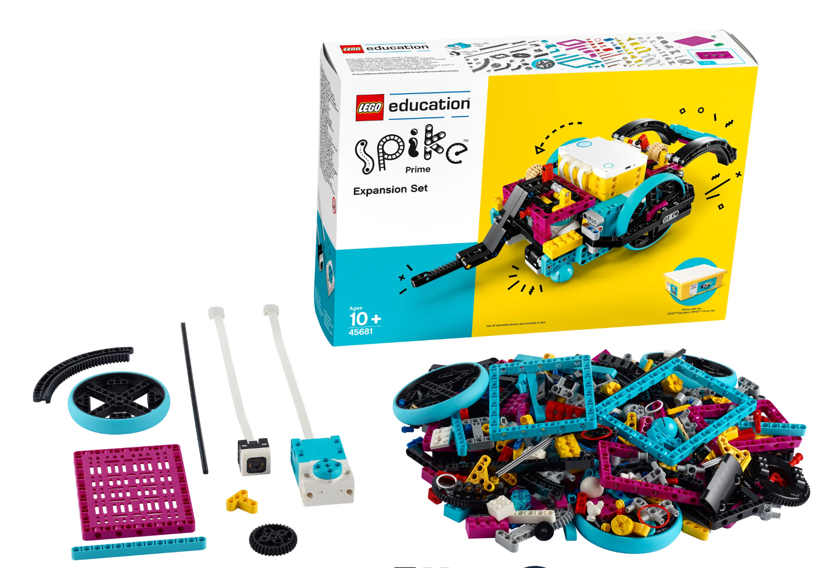
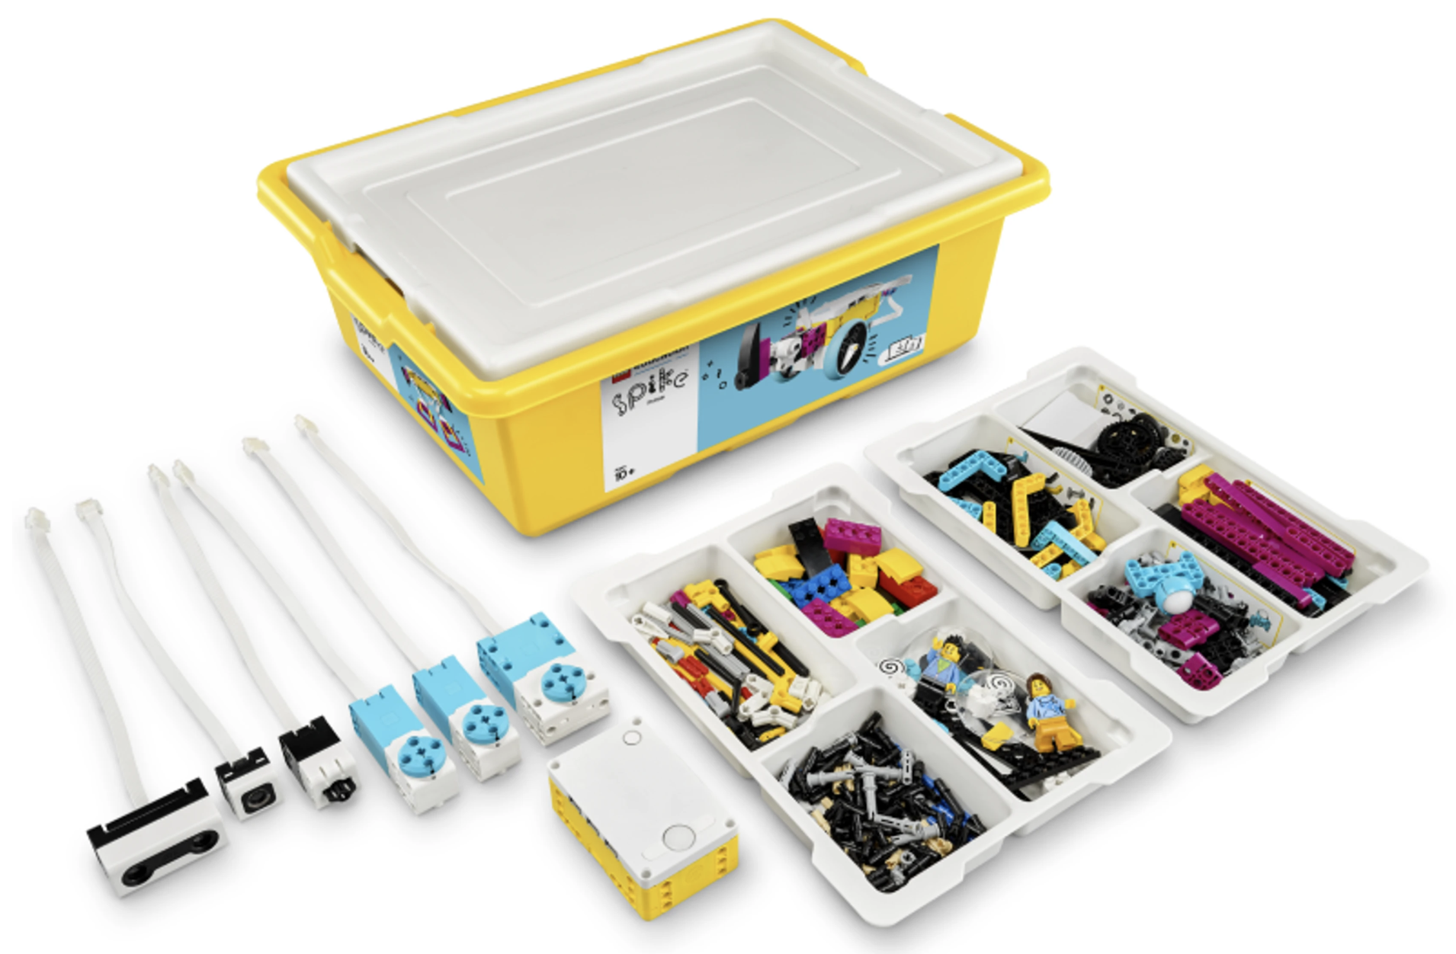
Parts….I need Parts!
The minimum viable Lego kits you need are:
  LEGO® Education SPIKE™ Prime Set, 45678
  LEGO® Education SPIKE™ Prime Expansion Set, 45681
  NOTE: Older Lego robots including EV3 and NXT are legal. Robot Inventor is the same hub as SPIKE Prime
However, for a competitive robot most teams need additional Technic pieces
  If you only have 2 large and 2 medium motors, use the large motors for the attachments - you need the torque!
We have a extensive parts list and locations on where to buy them in our docs
  Be careful about buying parts on Amazon and Ebay - not everything they sell are authentic parts and officially only Lego parts are allowed in competition
Notes:
Essentials for New Teams
22 July 2025
Revision 2.1
Robot Equipment & Parts
New FLL teams should invest, at a minimum, in the following Lego sets:
LEGO® Education SPIKE™ Prime Set, 45678
LEGO® Education SPIKE™ Prime Expansion Set, 45681
These are the bare minimum materials needed to have a robot potentially capable of scoring a couple hundred points in the robot game part of the competition. Ideally extra sets allow for more efficient use of time. This allows for students to build multiple robots and/or attachments in parallel and allows iteration of new attachments without destroying existing ones due to lack of pieces.
Spare Pieces
Building a collection of the following Technic pieces is recommended to successfully move beyond the Advanced Driving Base into more customized robot and attachment designs. A good introduction video into Technic parts is:
https://www.youtube.com/watch?v=wrTzz1ch-J8
And the FLLTutorials.com presentation at:
https://flltutorials.com/translations/en-us/RobotGame/TechnicBasics.pdf
Appendix A contains a list of Lego parts that teams should consider acquiring.
Bricklink and Brickowl are good places to order sets of individual pieces. You can also get Lego parts from Lego’s Pick-a-Brick site - though the shipping can be long if the parts are coming from Europe. More expensive pieces like Beams with Side Holes or Plates are generally cheaper on Pick-a-Brick than other sites.
Another great option to buy a lot of Lego pieces quickly and cheaply is acquiring previous mission sets that are sometimes sold at a discount at Qualifiers and States. FLL uses AndyMark (www.andymark.com) as the official reseller of previous FLL season courses. Most of the courses have a large amount of Technic pieces.
If the team has enough spare Lego parts, keeping old attachments and robots implementations can be beneficial in future seasons.
We strongly recommend keeping previous season boards and assembled missions. Using previous seasons after the competition season is over will help team mature their robot and attachment designs in a way they maximize reuse between seasons. If your organization has multiple teams including competition and recreational teams the previous seasons are great for growing new members of the competition teams.
Storage
Coaches should consider using storage containers like the following to store your Lego pieces and use the Brick Architect’s labels (https://brickarchitect.com/labels) on the drawers. This makes organizing and finding the pieces much easier.
Akro-Mils 10724 24-Drawer Plastic Drawer Storage Cabinet
Akro-Mils 10164 64-Drawer Plastic Drawer Storage Cabinet
Akro-Mils 10144 44-Drawer Plastic Drawer Storage Cabinet
The boxes that Lego provides for the Spike Prime robots are not good for transporting the robots. They are typically too shallow for many robots, can not hold many attachments, and (most importantly) the lids do not lock in place. The Sterilite 30Qt with Latching lid is a good example. The latching lid is critical to prevent spills becoming a disaster. Especially at competitions!
Computers
A minimum of at least one computer (preferably a laptop) is required. It is recommended that the laptops run Windows or MacOS. It is also recommended to have a 1:1 computer to robot ratio. This will allow each group (assuming each has a dedicated robot) within the team to develop, code and test their attachments at a time. It will also allow the team to split up between robot and innovation project work during team meetings - just be careful to make sure all team members contribute to all the core areas.
Web based Google Docs and Microsoft 365 work well. But local copies of Microsoft Office, OpenOffice/LibreOffice (both free), or Apple’s Pages and Keynote allow the kids to work offline and they can be used in presentations during the innovation and robot design presentations.
Linux can also be used, but teams should be mindful of the potentially higher “training” costs for kids and other parents. While Pybricks can work on Linux unless the team has robust IT support; Windows or MacOS should have a lower administrative burden. Lego Spike’s web app (https://spike.legoeducation.com) should run in Chrome on Linux.
Game Tables
FIRST publishes the specification for tables. If you decide to make your own tables, if at all possible avoid cutting the board in half. It will create imperfections that make programming and testing the robot more complicated. But if you have to make two pieces use a 48” piano hinge (on the bottom) to connect the sides while allowing them to fold. You might need ¼” 48” spacers to raise the bottom up slightly to cover the height of the hinge. Make sure you use latches on each side to hold the sides together when you unfold it.
In competition saw horses are usually used to hold the tables. However, care should be taken with using sawhorses for development and practice tables as kids are frequently dropping pieces on the floor, crawling under the tables to get them, and sawhorses are not known for their stability.
Some coaches have used Bora 30” high 8’x4’ Centipedes to support game tables, 29”x24” Folding Banquet Table Legs (attached to the table), and 8’x4’ card tables also work.
Programming
The Lego Spike applications for Windows, MacOS, and Browser/Chromebooks have detailed instructions on how to build a robot using the Advanced Driving Base and a number of attachments that can (perhaps with some modifications) be used to complete a number of missions in most FLL games.
A Windows or Apple laptop is recommended for competition. While a Chromebook will work however it may require an Internet connection to run the Lego Spike or Pybricks application if installation of software is not allowed - this is common on most school Chromebooks.
An alternative to the Lego Spike Application is Pybricks (pybricks.com). It supports Lego Spike hubs, Lego Technic hubs, and Lego Evo3 hubs. It can run over the Internet or it can be installed on a computer (no administrative rights necessary). While Pybricks’ python mode is free, its block coding mode (similar to Scratch and the block coding mode in Lego Spike) does require a small fee. The main advantages of Pybricks over Lego Spike is much better documentation, easy to use gyroscope support, supports code reuse through libraries, and a set of functions that are particularly well suited for the types of programming required for FLL.
Ultimately teams can be competitive using either Lego Spike or Pybricks Block Coding or Python versions. If coaches have Python programming experience and kids have sufficient computer skills, Pybricks python is an excellent way help kids enhance their programming skills.
Some coaches and kids have found debugging (find errors) in code is easier in Python.
Programming is covered in greater detail in our other documents.
Meeting Location & Space
Space is needed to support the team and mission model setup. Kids need space to build robots and attachments, the mission table itself is 8’x4’ and kids need space around the table to work on it.
Ideally have regular meeting times each week to work on the robot and innovation project. Having regular meetings sets expectations with parents and kids to encourage full participation of the team.
A whiteboard can be very helpful for the team members during their innovation project meetings.
Competitive teams will need to meet far more than 2-4 hours a week. It is not uncommon for at least one 4-6 hour in person meeting at a coach’s house, community center, or school every weekend for several months.
Competitive FLL teams are in many ways like competitive sports teams. They require dedication, resources, and lots of time.
Presentations at Competition
At the FLL competition the team will have 30 minutes to present and answer questions about their innovation project and present their robot and attachment design and their to them and their coding. Each presentation is 5 minutes with about 8 minutes of questions by the judges.
It is critical that all team members present equally in both presentations. Unequal presentations will likely cause the judge to specifically target those individuals during the Q&A sessions.
One trick some teams use is to tell the most talkative team members to avoid the first 1-2 questions; and vice versa the least talkative to get the first couple; these questions 'tend' to be easy. Count the number of questions they have answered and try to aim for 1 or 2. Keep answers short and to the point, this gives more time for questions and more chances to get higher scores.
In order to get the max points for the innovation project the team needs to bring a prototype of the innovation project.
Trifolds are commonly used for both presentations. Taking pictures during the evolution of the robot and attachments is one way to demonstrate the iterative design process (design, build, test, improve, repeat).
Coaches are allowed to record the video and audio during the presentation. An iPhone or Android phone with an external MIC usually works well.

Slide 104
Robot Design Presentation
Team is required to do a presentation on the design of the robot and attachments
It is recommended that there should be some visual (e.g., a trifold or poster) that shows which missions use which attachments
  Teams need to discuss why/how they selected the missions they did
  The task/mission approach should be discussed, the attachment(s) used
  Should provide a few of the coding examples
Team must clearly discuss how they were involved in the robot and attachment design, build, testing, refinement, and integration activities
  Use of previous season robots and attachments are ok, but the team needs to explain how they improved on it during the season to address the season’s unique challenges
  Consider using Lego’s free BrickLink Studio ”CAD Program” to document the design of the Robot and Attachments

Slide 105
Conclusion

Slide 106
Wait…. But I don’t know Python
There A LOT of free resources on the Internet to learn python
  https://www.w3schools.com/python
  https://www.tutorialspoint.com/python
  www.python.org
  docs.pybricks.com
This Presentation, my Python for FLL presentation, and the code examples are available at:
  https://github.com/bcfletcher/lego_projects/tree/main/FLL/2025_MD_FLL_Coaches_Conf

Slide 107
Summary
This was a introduction into Pybricks
It covered the key concepts and Pybricks APIs that teams will need to be successful using Pybricks
Pybricks has excellent documentation both within the Application and the website.
Pybrick’s support website has lots of good discussions and examples
  https://github.com/pybricks/support

Slide 108
Xbox Controller Example

Slide 109
Xbox Controller Example
This is example of how to use an Xbox Controller with a Lego Spike Prime Robot
It does not use the robot library
This was primarily an experiment in how to use the Xbox Controller to get angles and distances to objects on an FLL Course
It was inspired by a presentation from Julian Huss and Monongahela Cryptid Cooperative at the 2025 First Chesapeake Mentor Conference
  https://github.com/MonongahelaCryptidCooperative/FLL-Block-2024-2025/

Slide 110
Xbox Example (1/5)
from pybricks.hubs import PrimeHub
from pybricks.iodevices import XboxController
from pybricks.parameters import Button, Direction, Port, Stop
from pybricks.pupdevices import Motor
from pybricks.robotics import DriveBase
from pybricks.tools import wait
# Set up all devices.
prime_hub = PrimeHub()
right_motor = Motor(Port.A, Direction.CLOCKWISE)
left_motor = Motor(Port.B, Direction.COUNTERCLOCKWISE)
attachment_motor = Motor(Port.C, Direction.CLOCKWISE)
drive_base = DriveBase(left_motor, right_motor, 62.4, 204)
controller = XboxController()
# Initialize variables.
mySpeed = 950

Slide 111
Xbox Example (2/5)
def xbox_controller_test():
global mySpeed
print('Connected’)
drive_base.use_gyro(False)
drive_base.reset(0, 0)
drive_base.settings(straight_speed=mySpeed)
drive_base.settings(straight_acceleration=750)
while not Button.X in controller.buttons.pressed():
if Button.UP in controller.buttons.pressed():
print('forward’)
drive_base.straight(10, then=Stop.NONE)
wait(100)
elif Button.DOWN in controller.buttons.pressed():
print('backward’)
drive_base.straight(-10, then=Stop.NONE)
wait(100)
elif Button.LEFT in controller.buttons.pressed():
print('left', drive_base.angle())
drive_base.turn(-1, then=Stop.NONE)
wait(10)

Slide 112
Xbox Example (3/5)
elif Button.RIGHT in controller.buttons.pressed():
print('right', drive_base.angle())
drive_base.turn(1, then=Stop.NONE)
wait(10)
elif Button.A in controller.buttons.pressed():
drive_base.stop()
wait(100)
elif Button.B in controller.buttons.pressed():
print('B_dist=', drive_base.distance())
wait(100)
elif Button.Y in controller.buttons.pressed():
print('Y_angle=', drive_base.angle(), ‘ hub_heading=‘, prime_hub.imu.heading())
wait(100)
elif Button.RB in controller.buttons.pressed():
attachment_motor.run_angle(900, -190, Stop.COAST)
wait(100)

Slide 113
Xbox Example (4/5)
elif Button.LB in controller.buttons.pressed():
attachment_motor.run_angle(900, 190, Stop.COAST)
wait(100)
elif Button.MENU in controller.buttons.pressed():
print('Dist/Angle Reset’)
drive_base.reset(0, 0)
prime_hub.imu.reset_heading(0)
drive_base.settings(straight_speed=10)
mySpeed = 10
wait(100)
elif Button.VIEW in controller.buttons.pressed():
mySpeed = mySpeed + 10
print('Up Speed=', mySpeed)
if mySpeed > 960: mySpeed = 950
drive_base.settings(straight_speed=mySpeed)
wait(100)

Slide 114
Xbox Example (5/5)
elif Button.UPLOAD in controller.buttons.pressed():
mySpeed = mySpeed - 10
print('Down Speed=', mySpeed)
if mySpeed <= 10: mySpeed = 10
drive_base.settings(straight_speed=mySpeed)
wait(100)
else:
wait(100)
print('Program Ended’)
drive_base.stop()
attachment_motor.stop()
drive_base.use_gyro(False)

